Slide 1

CSCI E-96 Data Mining, Exploration and Discovery Introduction to Clustering Models Part 2
Steve Elston
Copyright 2020,2021, 2022, 2023, 2024, 2025, Stephen F Elston. All rights reserved.

Slide 2
Algorithms for Non-Euclidean Spaces
Euclidean spaces are optimal only for Normally distributed variables
Common examples of variables in non-Euclidean spaces
Categorical variables including NLP problems
Binary variables
Ordinal variables
Algorithms for non-Euclidian spaces
Tree-graph-based Agglomerative clustering
Graph-based affinity clustering
NN graph-based density algorithms
NN graph-based spectral clustering

Slide 3
K-Mediods and CLARA

Slide 4
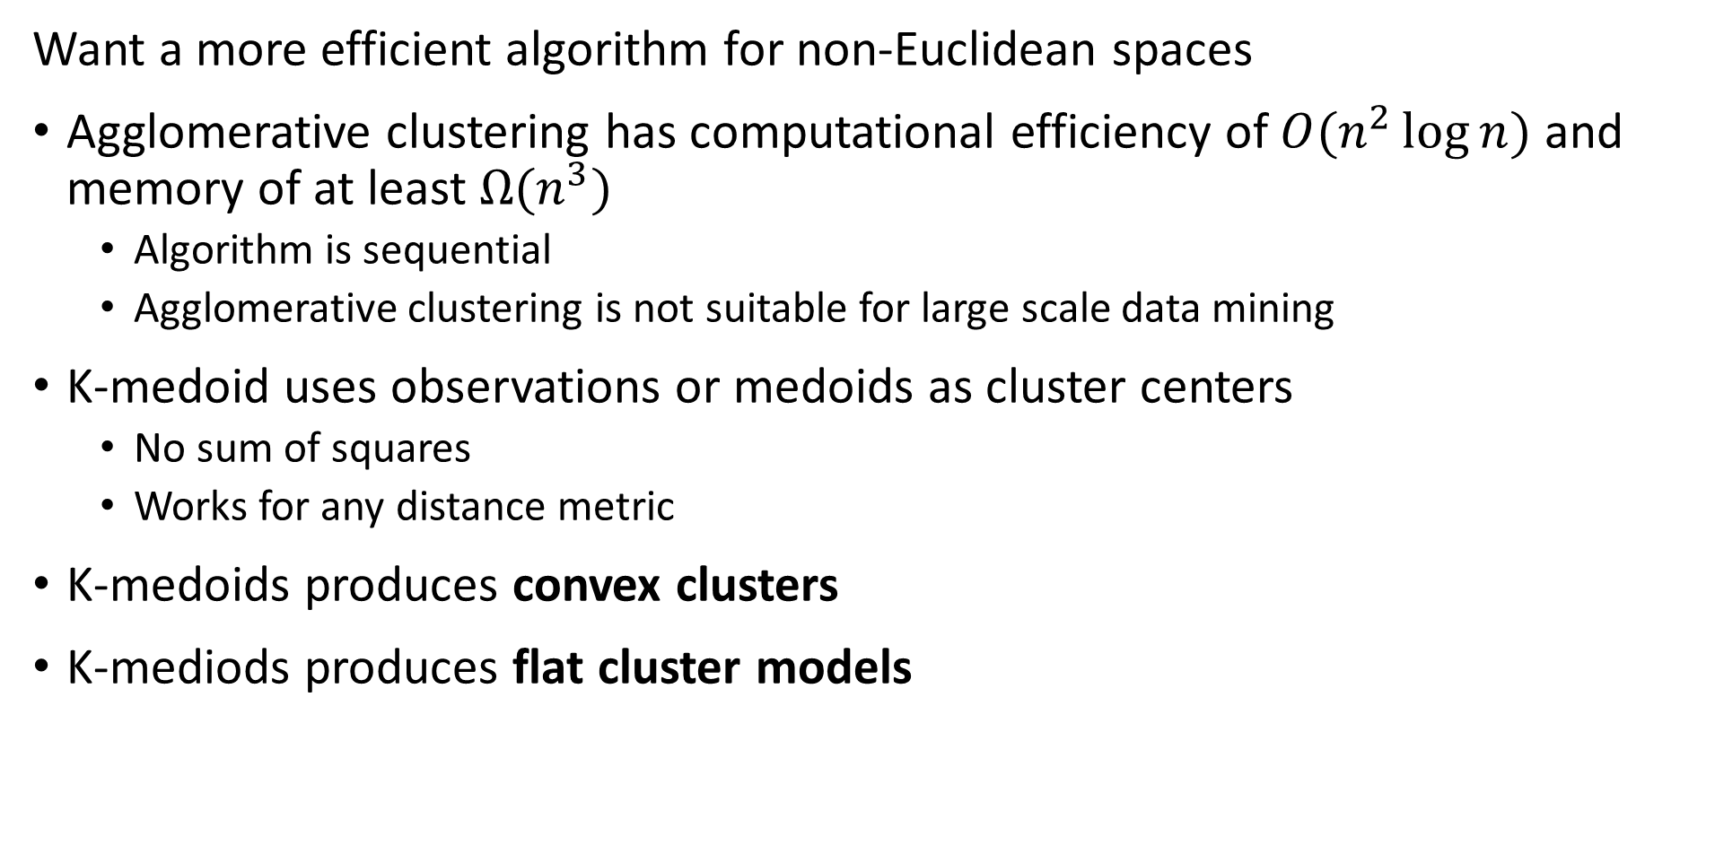
K-medoids Algorithm
Want a more efficient algorithm for non-Euclidean spaces
Agglomerative clustering has computational efficiency of $O(n^{2}\log{n})$ and memory of at least $Ω(n^{3})$
Algorithm is sequential
Agglomerative clustering is not suitable for large scale data mining
K-medoid uses observations or medoids as cluster centers
No sum of squares
Works for any distance metric
K-medoids produces convex clusters
K-mediods produces flat cluster models

Slide 5
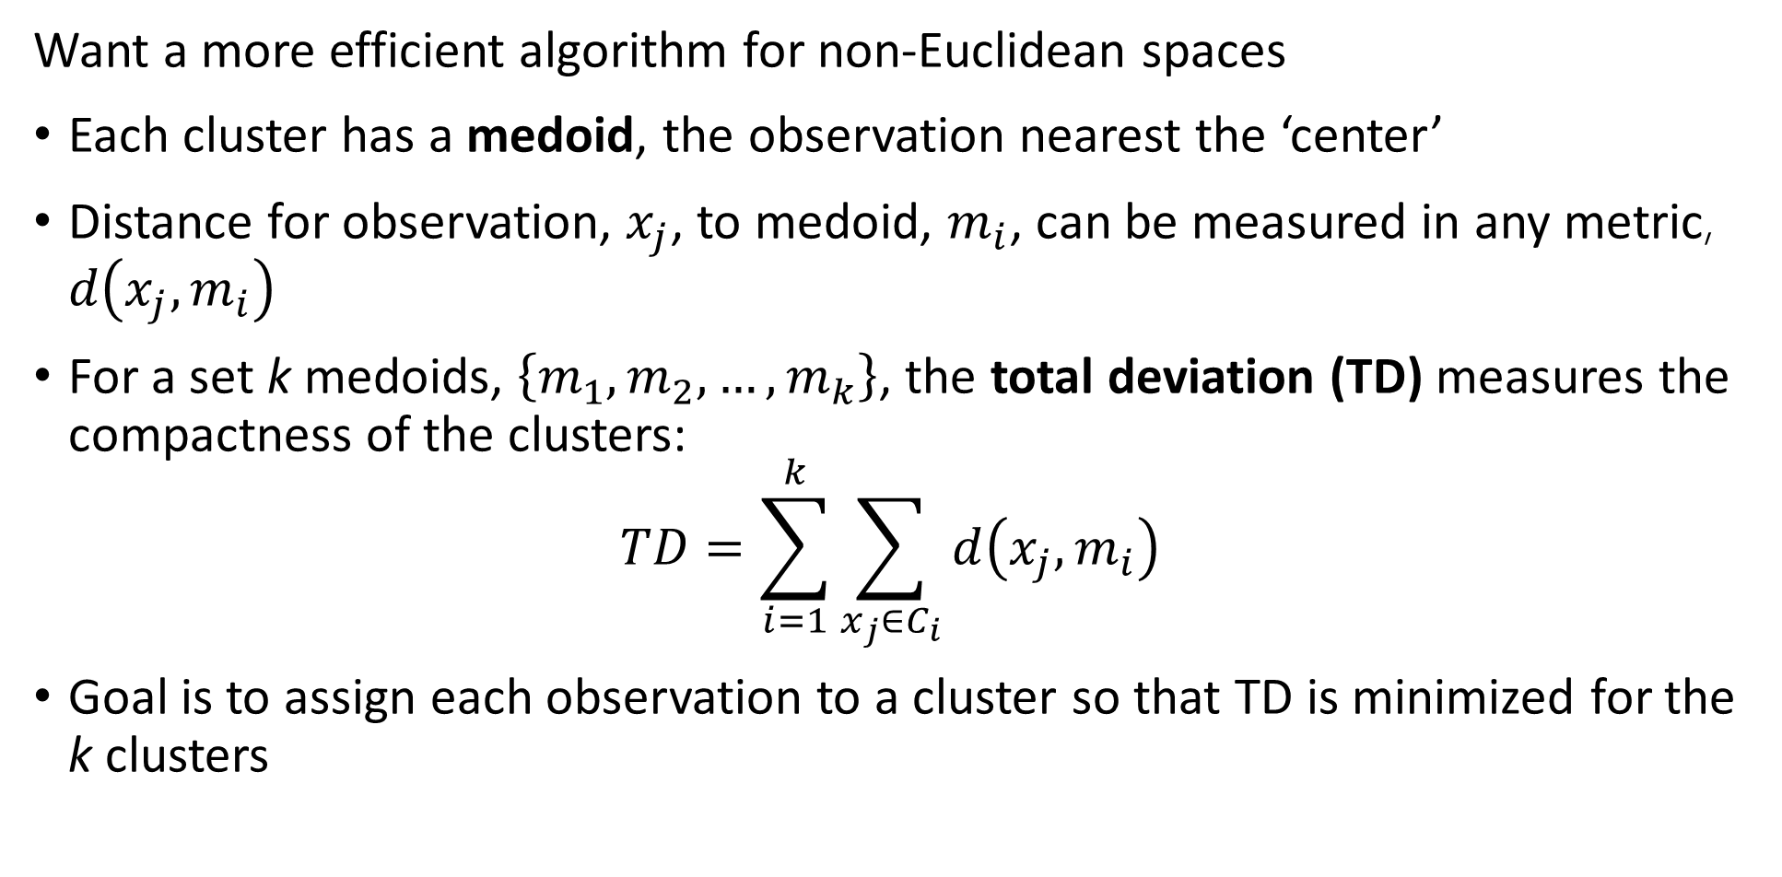
K-medoids Algorithm
Want a more efficient algorithm for non-Euclidean spaces
Each cluster has a medoid, the observation nearest the ‘center’
Distance for observation, $x_{j}$, to medoid, $m_{i}$, can be measured in any metric, $d\left(x_{j},m_{i}\right)$
For a set k medoids, $\left\{m_{1},m_{2},…,m_{k}\right\}$, the total deviation (TD) measures the compactness of the clusters:
$$TD=\sum_{i=1}^{k}{\sum_{x_{j}∈C_{i}}^{ }{d\left(x_{j},m_{i}\right)}}$$
Goal is to assign each observation to a cluster so that TD is minimized for the k clusters

Slide 6
K-medoids Algorithm
Many variations of the k-medoids have been developed
Partitioning Around Mediods (PAM) algorithm, was an early k-medoid algorithm
PAM algorithm has two steps:
Build step finds initial cluster assignments
Swap step improves cluster assignments

Slide 7
K-medoids Algorithm
Partitioning Around Mediods (PAM) algorithm was early k-medoid algorithm
Build step finds initial cluster assignments
# Find first medoid by greedy algorithm
Find a medoid observation with minimum total deviation (TD)
Assign as m1
# Sequentially find remaining medoids by greedy partitioning
For j in range(2,k):
find observation that partitions the observations with minimum TD
Assign as mj
Build is a greedy algorithm
Once an observation is assigned as a medoid the assignment is fixed
Build algorithm empirically superior to random starts for k-medoids

Slide 8
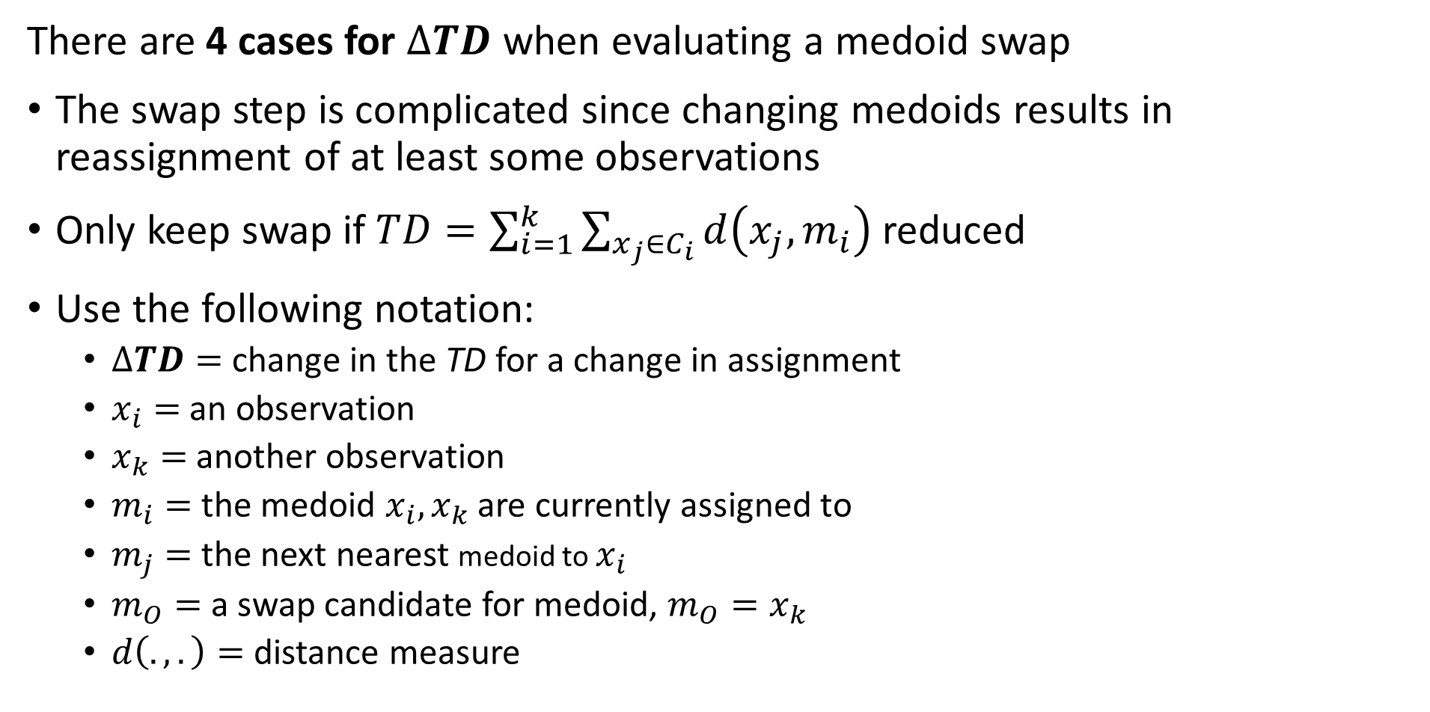
K-medoids Algorithm
There are 4 cases for $∆TD$ when evaluating a medoid swap
The swap step is complicated since changing medoids results in reassignment of at least some observations
Only keep swap if$TD=\sum_{i=1}^{k}{\sum_{x_{j}∈C_{i}}^{ }{d\left(x_{j},m_{i}\right)}}$ reduced
Use the following notation:
$∆TD=$ change in the TD for a change in assignment
$x_{i}=$ an observation
$x_{k}=$ another observation
$m_{i}=$ the medoid $x_{i},x_{k}$ are currently assigned to
$m_{j}=$ the next nearest medoid to $x_{i}$
$m_{O}=$ a swap candidate for medoid, $m_{O}=x_{k}$
$d\left(.,.\right)=$ distance measure

Slide 9
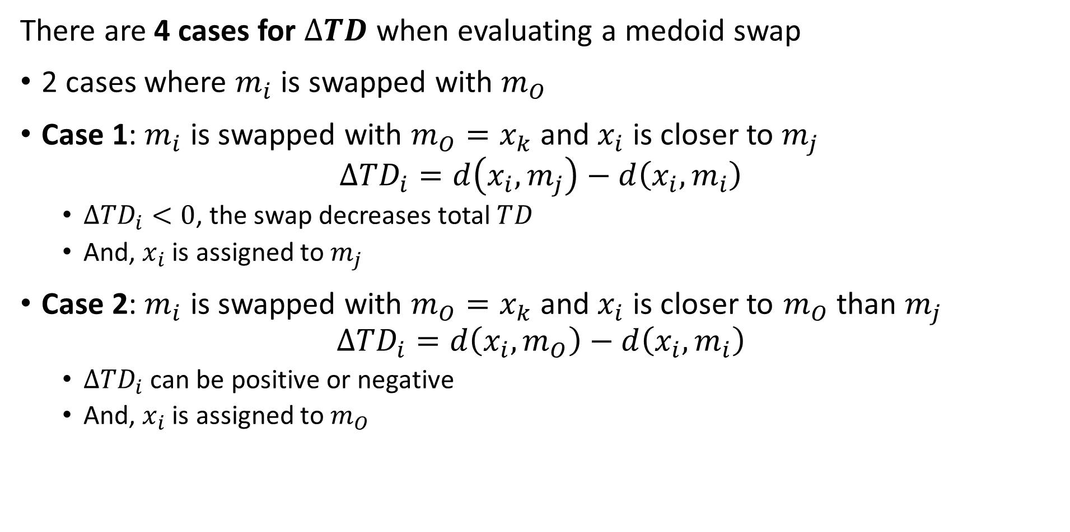
K-medoids Algorithm
There are 4 cases for $∆TD$ when evaluating a medoid swap
2 cases where $m_{i}$ is swapped with $m_{O}$
Case 1: $m_{i}$ is swapped with $m_{O}=x_{k}$ and $x_{i}$ is closer to $m_{j}$
$$∆TD_{i}=d\left(x_{i},m_{j}\right)−d\left(x_{i},m_{i}\right)$$
$∆TD_{i}<0$, the swap decreases total $TD_{ }$
And, $x_{i}$ is assigned to $m_{j}$
Case 2: $m_{i}$ is swapped with $m_{O}=x_{k}$ and $x_{i}$ is closer to $m_{O}$ than $m_{j}$
$$∆TD_{i}=d\left(x_{i},m_{O}\right)−d\left(x_{i},m_{i}\right)$$
$∆TD_{i}$ can be positive or negative
And, $x_{i}$ is assigned to $m_{O}$

Slide 10
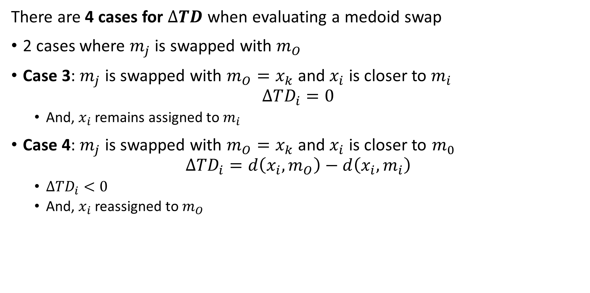
K-medoids Algorithm
There are 4 cases for $∆TD$ when evaluating a medoid swap
2 cases where $m_{j}$ is swapped with $m_{O}$
Case 3: $m_{j}$ is swapped with $m_{O}=x_{k}$ and $x_{i}$ is closer to $m_{i}$
$$∆TD_{i}=0$$
And, $x_{i}$ remains assigned to $m_{i}$
Case 4: $m_{j}$ is swapped with $m_{O}=x_{k}$ and $x_{i}$ is closer to $m_{0}$
$$∆TD_{i}=d\left(x_{i},m_{O}\right)−d\left(x_{i},m_{i}\right)$$
$∆TD_{i}<0$
And, $x_{i}$ reassigned to $m_{O}$

Slide 11
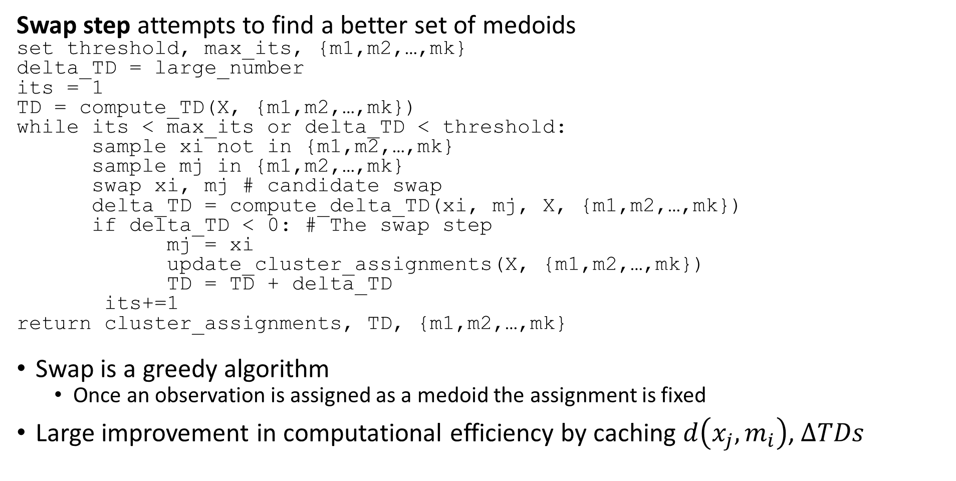
K-medoids Algorithm
Swap step attempts to find a better set of medoids
set threshold, max_its, {m1,m2,…,mk}
delta_TD = large_number
its = 1
TD = compute_TD(X, {m1,m2,…,mk})
while its < max_its or delta_TD < threshold:
sample xi not in {m1,m2,…,mk}
sample mj in {m1,m2,…,mk}
swap xi, mj # candidate swap
delta_TD = compute_delta_TD(xi, mj, X, {m1,m2,…,mk})
if delta_TD < 0: # The swap step
mj = xi
update_cluster_assignments(X, {m1,m2,…,mk})
TD = TD + delta_TD
its+=1
return cluster_assignments, TD, {m1,m2,…,mk}
Swap is a greedy algorithm
Once an observation is assigned as a medoid the assignment is fixed
Large improvement in computational efficiency by caching $d\left(x_{j},m_{i}\right)$, $∆TDs$

Slide 12
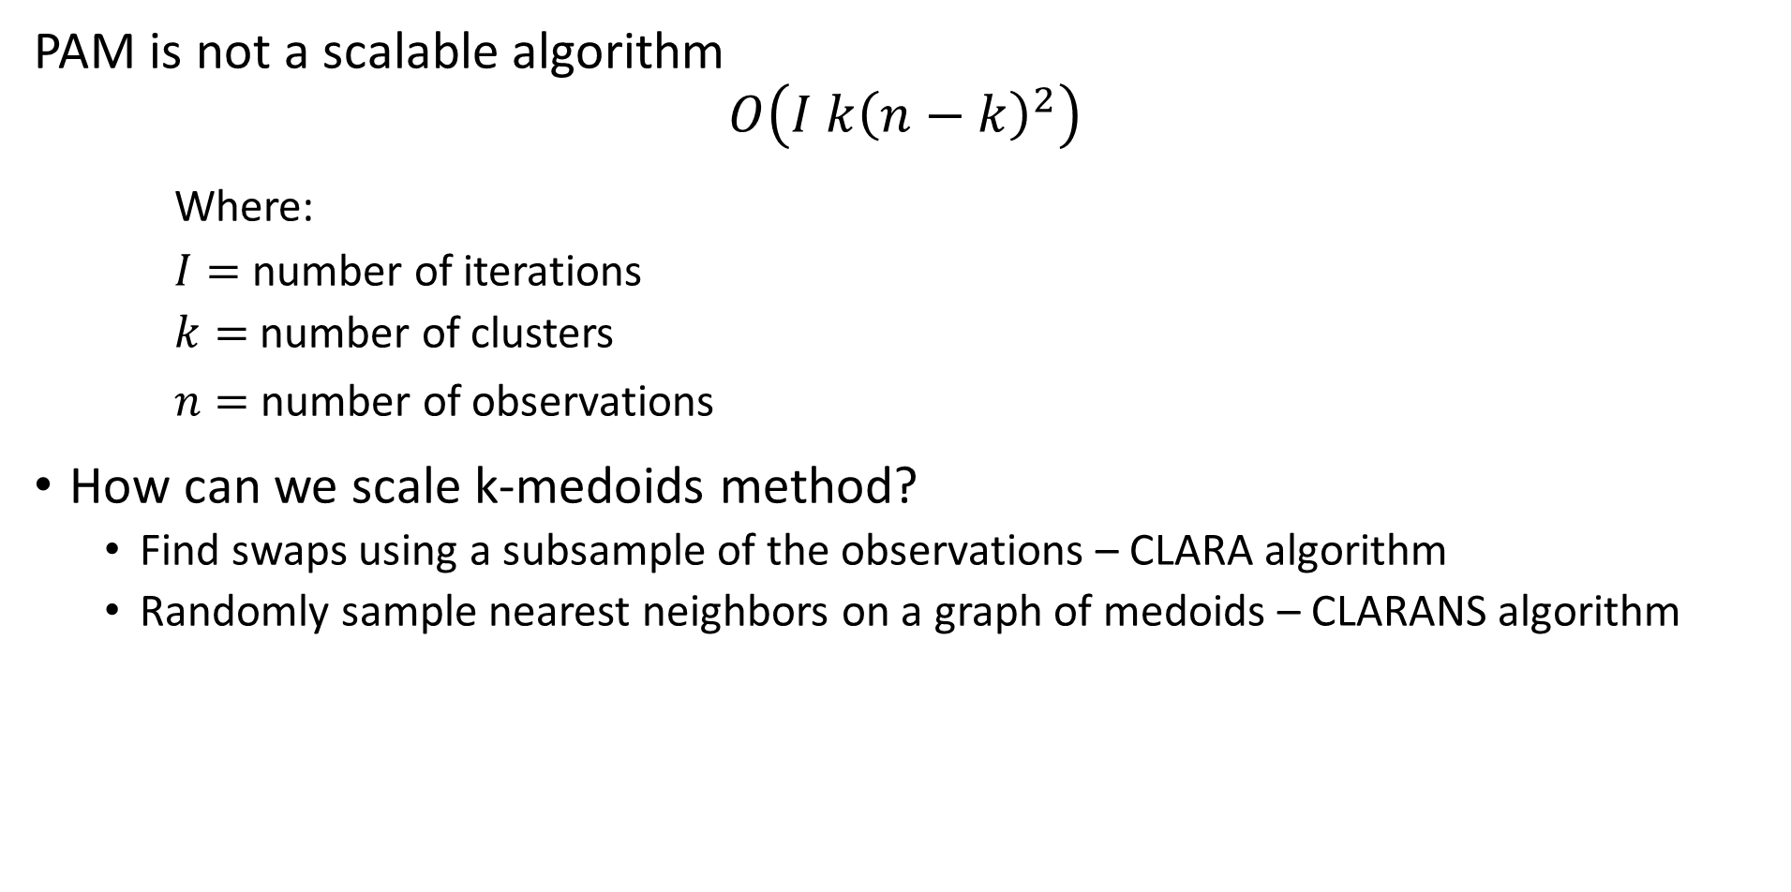
K-medoids Algorithm
PAM is not a scalable algorithm
$$O\left(I k{\left(n−k\right)}^{2}\right)$$
Where:
$I=$ number of iterations
$k=$ number of clusters
$n=$ number of observations
How can we scale k-medoids method?
Find swaps using a subsample of the observations – CLARA algorithm
Randomly sample nearest neighbors on a graph of medoids – CLARANS algorithm

Slide 13
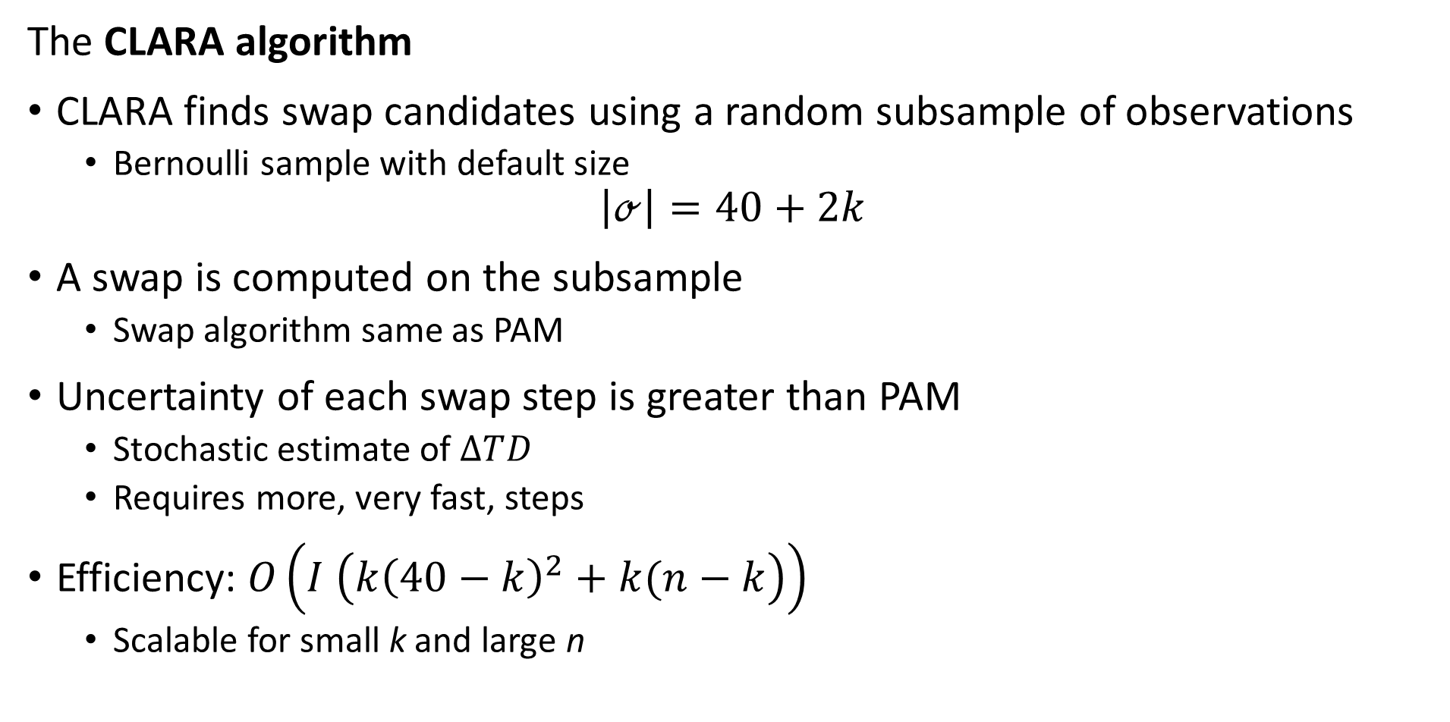
K-medoids Algorithm
The CLARA algorithm
CLARA finds swap candidates using a random subsample of observations
Bernoulli sample with default size
$$\left|ℴ\right|=40+2k$$
A swap is computed on the subsample
Swap algorithm same as PAM
Uncertainty of each swap step is greater than PAM
Stochastic estimate of $∆TD_{ }$
Requires more, very fast, steps
Efficiency: $O\left(I \left(k{\left(40−k\right)}^{2}+k(n−k\right)\right)$
Scalable for small k and large n

Slide 14
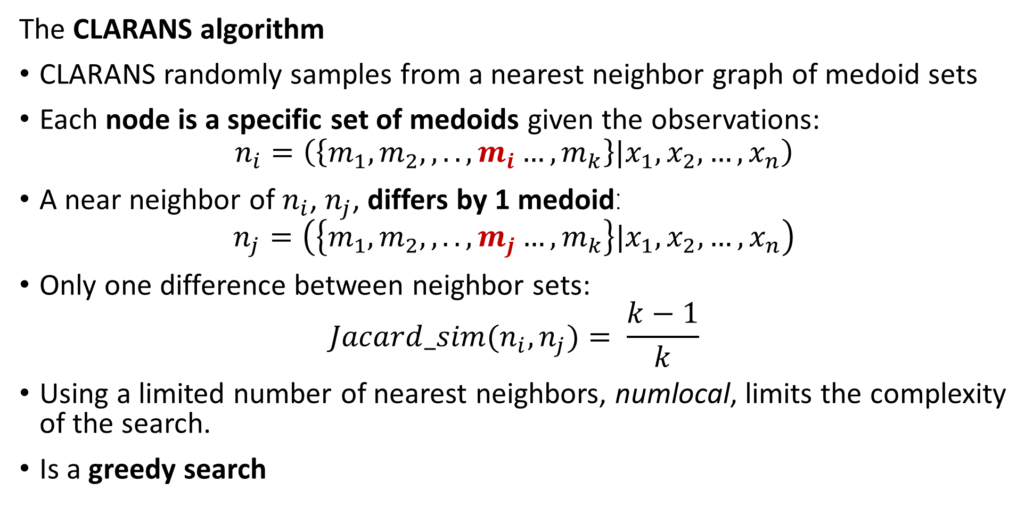
K-medoids Algorithm
The CLARANS algorithm
CLARANS randomly samples from a nearest neighbor graph of medoid sets
Each node is a specific set of medoids given the observations:
$$n_{i}=\left(\left\{m_{1},m_{2},,..,m_{i}…,m_{k}\right\}|x_{1},x_{2},…,x_{n}\right)$$
A near neighbor of $n_{i}$, $n_{j}$, differs by 1 medoid:
$$n_{j}=\left(\left\{m_{1},m_{2},,..,m_{j}…,m_{k}\right\}|x_{1},x_{2},…,x_{n}\right)$$
Only one difference between neighbor sets:
$$Jacard_sim(n_{i},n_{j})= \frac{k−1}{k}$$
Using a limited number of nearest neighbors, numlocal, limits the complexity of the search.
Is a greedy search

Slide 15
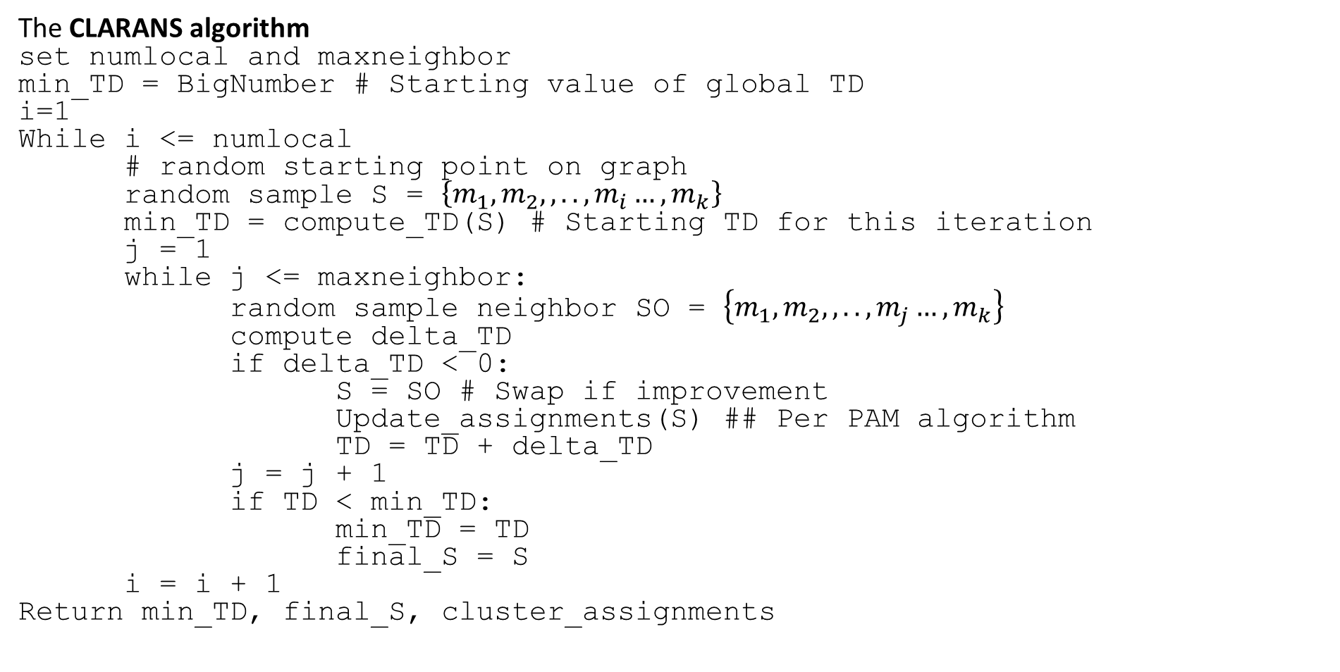
K-medoids Algorithm
The CLARANS algorithm
set numlocal and maxneighbor
min_TD = BigNumber # Starting value of global TD
i=1
While i <= numlocal
# random starting point on graph
random sample S = $\left\{m_{1},m_{2},,..,m_{i}…, m_{k}\right\}$
min_TD = compute_TD(S) # Starting TD for this iteration
j = 1
while j <= maxneighbor:
random sample neighbor SO = $\left\{m_{1},m_{2},,..,m_{j}…,m_{k}\right\}$
compute delta_TD
if delta_TD < 0:
S = SO # Swap if improvement
Update_assignments(S) ## Per PAM algorithm
TD = TD + delta_TD
j = j + 1
if TD < min_TD:
min_TD = TD
final_S = S
i = i + 1
Return min_TD, final_S, cluster_assignments

Slide 16
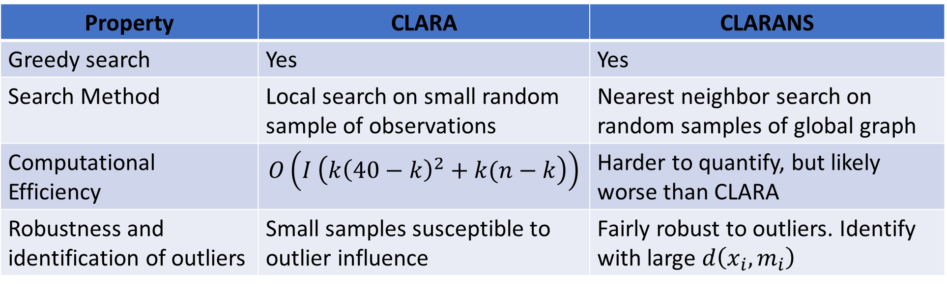
K-medoids Algorithm
Compare CLARA and CLARANS algorithms
Property | CLARA | CLARANS
Greedy search | Yes | Yes
Search Method | Local search on small random sample of observations | Nearest neighbor search on random samples of global graph
Computational Efficiency | $$O\left(I \left(k{\left(40−k\right)}^{2}+k(n−k\right)\right)$$ | Harder to quantify, but likely worse than CLARA
Robustness and identification of outliers | Small samples susceptible to outlier influence | Fairly robust to outliers. Identify with large $d\left(x_{i},m_{i}\right)$

Slide 17
K-medoids Algorithm
There is on-going research into scalable K-medoids algorithms
The original PAM algorithm was first published as Chapter 2 of Finding Groups in Data, Kaufmann and Rousseeuw, Wiley, 1990
The original CLARANS paper is behind paywalls, for a review of k-medoids methods including CLARANS: a method for clustering objects for spatial data, Ng and Hue, 2002
A recently developed algorithm to significantly improve the scalability of k-medoids algorithm can be found in Faster k-Medoids Clustering: Improving the PAM, CLARA, and CLARANS Algorithms, Schubert and Rousseeuw, 2019
For a reasonable up to date review and comparison of K-medoids algorithms see An Overview of Partitioning Algorithms in Clustering Techniques, Skaget and Pandya, 2016

Slide 18
K-medoids Algorithm
Python API software for K-medoids algorithms
The PAM and CLARA algorithms are implemented in Scikit-Extra package
Conforms to Scikit standards for API and good documentation
A versions of the PAM algorithm, CLARANS algorithm and several other clustering algorithms and utilities are implemented in the Pyclustering package
Unfortunately, this package has some rough edges and is not well documented

Slide 19
Graph-Based Clustering Models

Slide 20
Graph Based Clustering Models
Many cluster models use a graph-based associations
A graph is constructed for the distance or similarity relationships
Observations (samples) are nodes
Edges connect samples
Edge weights are distance or similarity
Relationships on the graph are used to separate data into clusters
Several commonly used classes of clustering algorithms are graph-based
Hierarchical
Affinity clustering
Density clustering
Spectral clustering

Slide 21
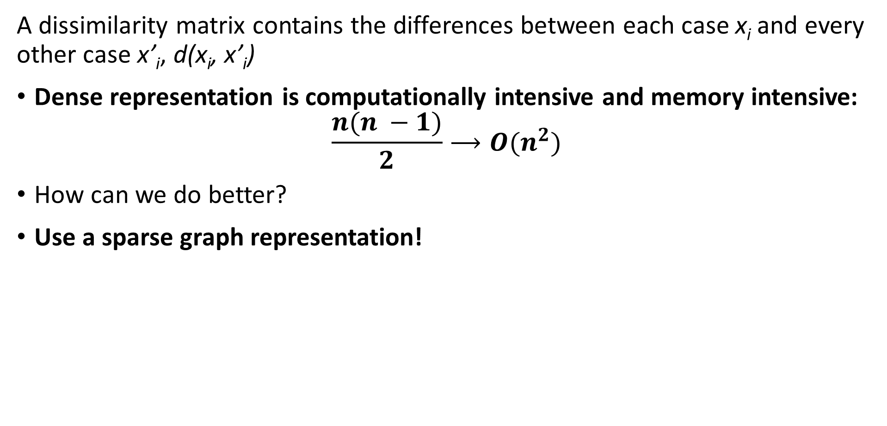
Scaling distance and similarity measures
A dissimilarity matrix contains the differences between each case x_{i} and every other case x’_{i}, d(x_{i}, x’_{i})
Dense representation is computationally intensive and memory intensive:
$$\frac{{n(n}^{ }−1)}{2}⟶O(n^{2})$$
How can we do better?
Use a sparse graph representation!

Slide 22
Scaling distance and similarity measures
A dissimilarity matrix contains the differences between each case x_{i} and every other case x’_{i}, d(x_{i}, x’_{i})
Sparse graph representation reduces computation and memory use
The sparser the graph the greater the approximation
In many practical situations only need metric for closest neighbors
Construct graph of nearest neighbors
Only compute and store metric for edges between nearest neighbors
Approximation ignores other associations
Ways to define nearest neighbor
Neighbors within distance r
Nearest k neighbors

Slide 23
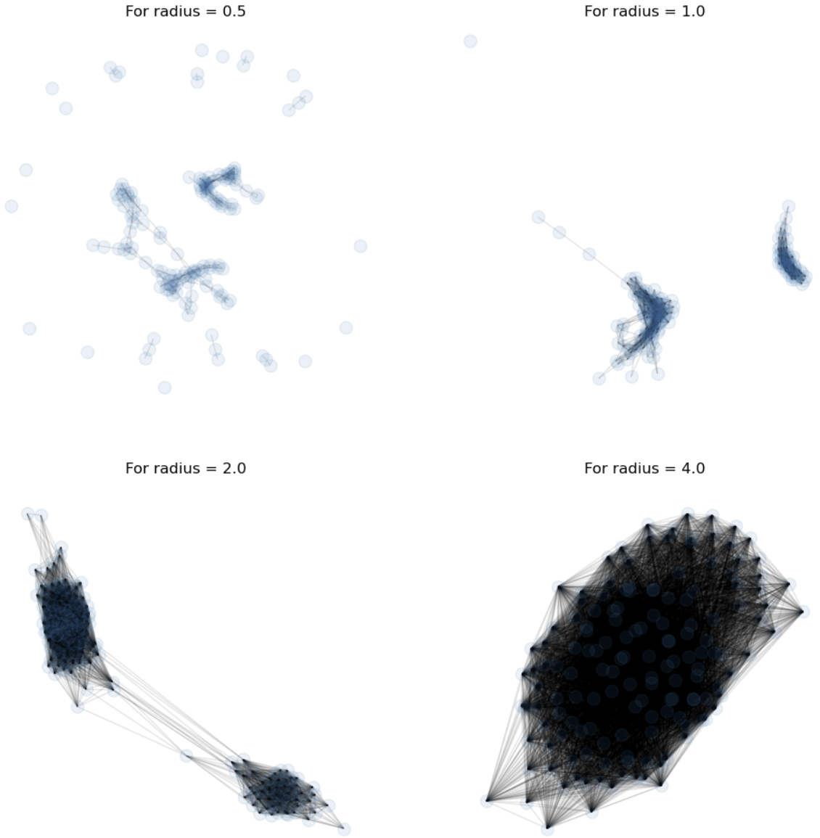
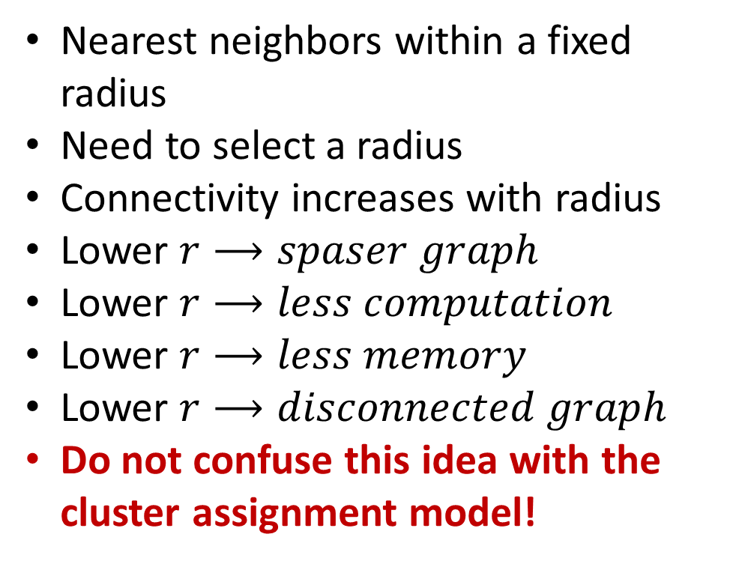
Scaling distance and similarity measures
Sparse graph representation reduces computation and memory use
Nearest neighbors within a fixed radius
Need to select a radius
Connectivity increases with radius
Lower $r⟶spaser graph$
Lower $r⟶less computation$
Lower $r⟶less memory$
Lower $r⟶disconnected graph$
Do not confuse this idea with the cluster assignment model!

Slide 24
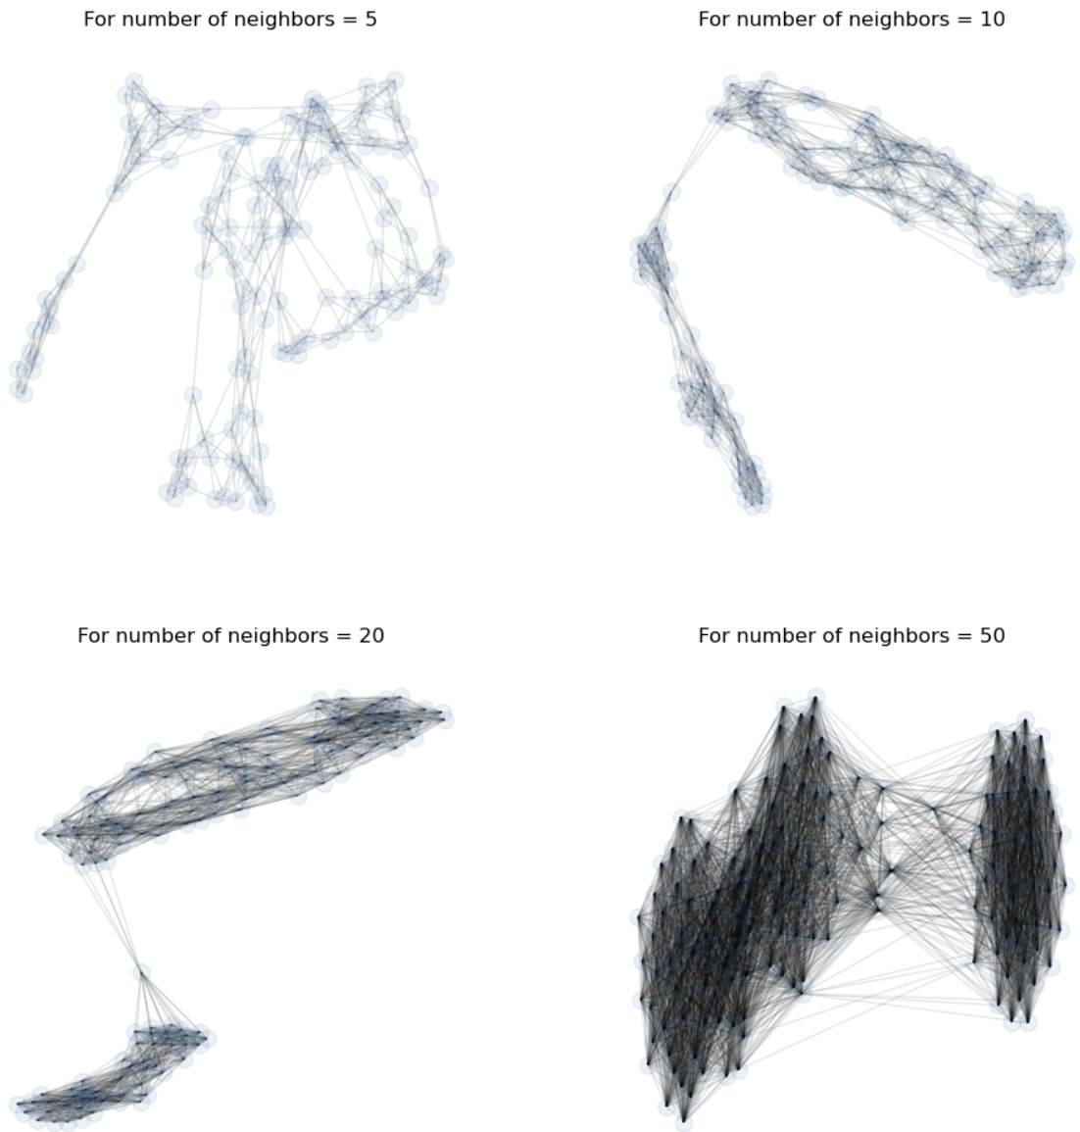
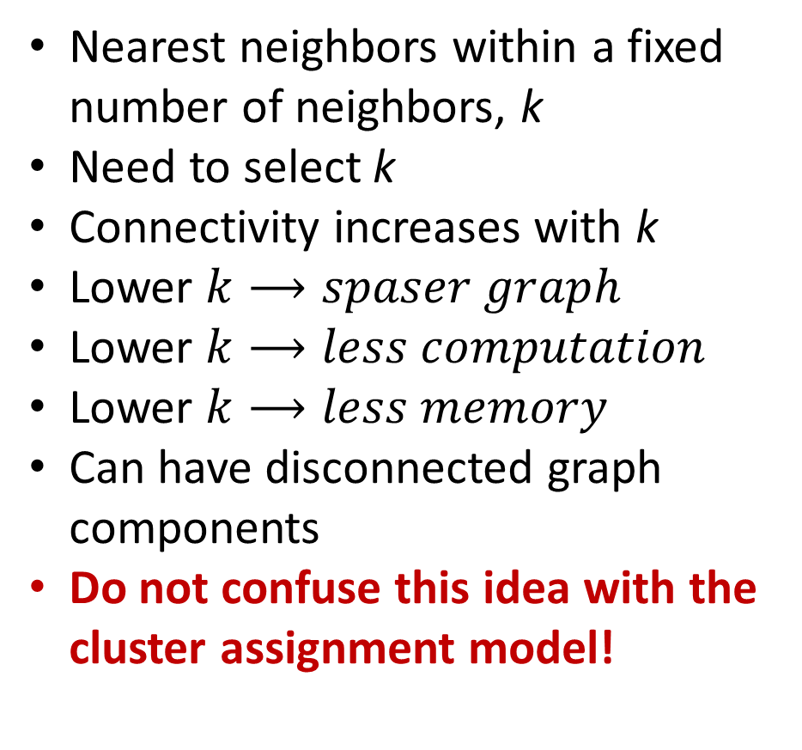
Scaling distance and similarity measures
Sparse graph representation reduces computation and memory use
Nearest neighbors within a fixed number of neighbors, k
Need to select k
Connectivity increases with k
Lower $k⟶spaser graph$
Lower $k⟶less computation$
Lower $k⟶less memory$
Can have disconnected graph components
Do not confuse this idea with the cluster assignment model!

Slide 25
Affinity-Based Clustering Models

Slide 26
Affinity Clustering
Can we build a clustering algorithm using a mapping to a few prototypes or exemplar points?
Yes
Affinity clustering uses a message passing algorithm to find these responsible or exemplar points and create a graph of cluster members
Affinity clustering provides useful results in many situations
Document similarity
Computer vision
Computational genetics
Etc.

Slide 27
Affinity Clustering
Can we build a clustering algorithm using a relationship to a few prototypes or exemplar points?
The number of representative points, and clusters, are determined by the algorithms
No need to specify number of clusters apriori
The message passing algorithm iteratively determines
Responsibility, r(i,k), of sample k to be the exemplar of sample i
Availability, a(i,k), of sample k to be a member of cluster with exemplar i
Exemplar points are central nodes of a graph component, or cluster
Graph components have no edges between them
Samples in component are connected to the exemplars by undirected edges

Slide 28
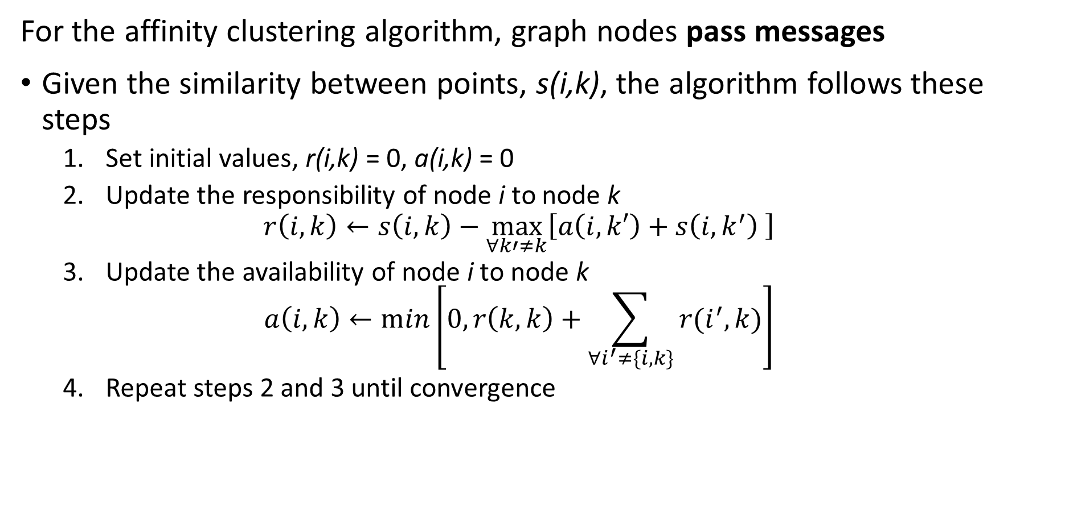
Affinity Clustering
For the affinity clustering algorithm, graph nodes pass messages
Given the similarity between points, s(i,k), the algorithm follows these steps
Set initial values, r(i,k) = 0, a(i,k) = 0
Update the responsibility of node i to node k
$$r\left(i,k\right)←s\left(i,k\right)−\max_{∀k′≠k}{⁡\left[a\left(i,k′\right)+s\left(i,k^{′}\right) \right]}$$
Update the availability of node i to node k
$$a\left(i,k\right)←min⁡\left[0,r\left(k,k\right)+\sum_{∀i^{′}≠\{i,k\}}^{ }{r(i^{′},k)}\right]$$
Repeat steps 2 and 3 until convergence

Slide 29
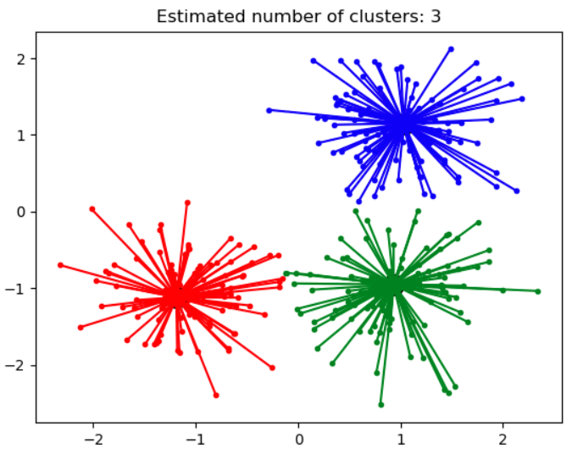
Affinity Clustering
Affinity propagation determines a number of clusters
Clusters linearly separated and convex
Clusters area Voronoi regions
Different similarity metrics create different clusters
Algorithm can be slow, O(n²) complexity
Credit: Scikit-Learn development team; Pedregosa et al., JMLR 12, pp. 2825-2830, 2011

Slide 30
Density-Based Clustering Models

Slide 31
Density Clustering
Using sample density is another way to form clusters
High density points form clusters
How can we find high density points?
Find points with large number of near neighbors
Form clusters around these high density points
Naive algorithms have high complexity
Scalable algorithms are largely heuristic
Many algorithms proposed, including
DBSCAN
OPTICS

Slide 32
Density Clustering
DBSCAN was the first (1996) large-scale density-based clustering algorithm
DBSCAN still in use today
Many variations created
DBSCAN scales to out of memory dataset size
DBSCAN minimizes the number of passes through the data base
Can scale DBSCAN with MapReduce

Slide 33
Density Clustering
DBSCAN finds a directed graph of nearest neighbors
Core points define the high density areas
Reachable non-core points are in a cluster but not core
Unreachable points are not in a cluster, outliers
Graph edge is bidirectional (undirected) if both points are core
Graph edges from core to reachable non-core point are unidirectional (directed)

Slide 34
Density Clustering
Properties of DBSCAN algorithm
DBSCAN has two hyperparameters
minPts is the minimum number of near neighbors a core point must have
ε is the maximum distance between neighbors
DBSCAN makes passes thorough a database to create the graph
Scalable, average runtime O(n log(n))
Uses memory, O(n²)

Slide 35
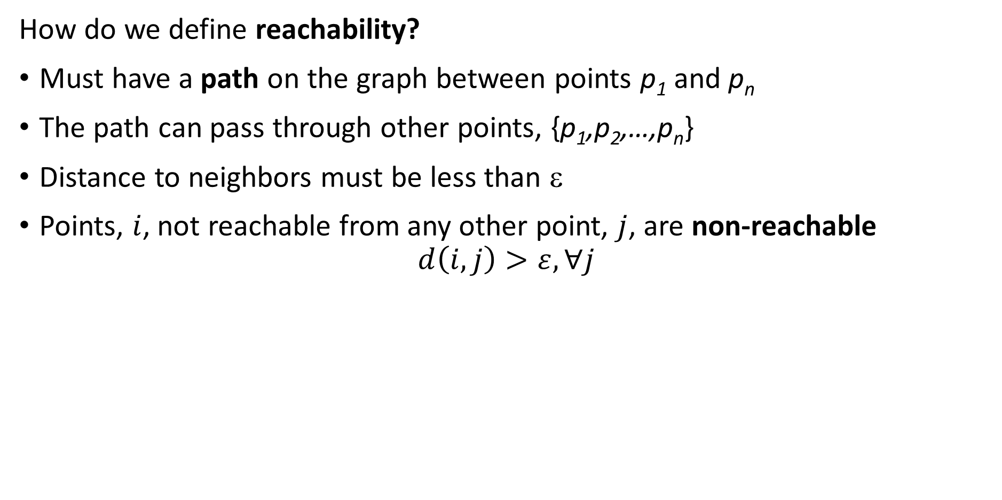
Density Clustering
How do we define reachability?
Must have a path on the graph between points p₁ and p_{n}
The path can pass through other points, {p₁,p₂,…,p_{n}}
Distance to neighbors must be less than ε
Points, $i$, not reachable from any other point, $j$, are non-reachable
$$d\left(i,j\right)>ε, ∀j$$

Slide 36
Density Clustering
What are the steps of DBSCAN?
Start with some samples or observations
For each point, find near neighbors within distance ε
A point is core if it has > minPts near neighbors (2 in this example)
If two point are core, connect with undirected edge
If point is non-core, connect with directed edge
If point further that ε from neighbors, point is non-reachable
Result is an NN graph

Slide 37
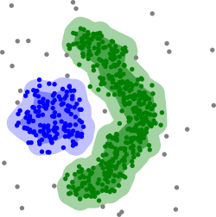
Density Clustering
What are some properties of DBSCAN?
Can find non-convex clusters
Is fast and efficient
Optimized for uniform sample density of clusters with fixed ε and minPts
Selecting maximum distance to neighbors, ε, is difficult in high dimensions
Clusters depend on distance metric
Clusters robust to noise, since outliers are non-reachable
Credit: Wikipedia commons

Slide 38
Density Clustering
How can we overcome the limitations of DBSCAN?
Optimized for uniform density clusters
Hard to find good value of ε in high dimensions
The OPTICS algorithm is an improvement on DBSCAN
OPTICS uses a heuristic adaptively compute reachability distances
Core distance determines if a sample is core
Reachability distance determines if one sample is reachable from the other
Only one mandatory hyperparameter, min_pts

Slide 39
Density Clustering
OPTICS is performs a sequential search
OPTICS compute reachability to points sequentially
The order of the search though observations matters
OPTICS algorithm sequentially builds a dendrogram, a graph
A difference from DBSCAN
Uses a sequential greedy algorithm with reachability of a point determining if it is added to the dendogram
Creates a reachability graph
Points are saved in a queue and processed in order
Reachability dynamically calculated based on neighbors on graph
Reachability search is done for nearest neighbors
Based on the reachability graph clusters are formed
Clusters formed by partitioning graph constrained by min_pts

Slide 40
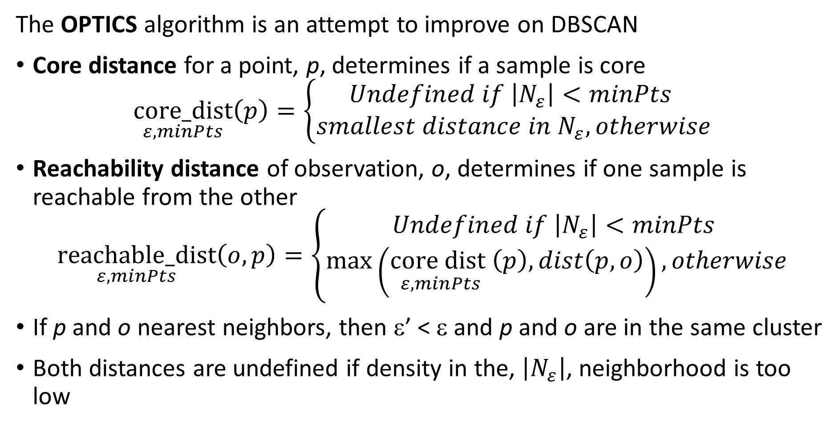
Density Clustering
The OPTICS algorithm is an attempt to improve on DBSCAN
Core distance for a point, p, determines if a sample is core
$$\underset{ε,minPts}{core_dist}\left(p\right)=\left\{\begin{aligned}Undefined if \left|N_{ε}\right|<minPts \\ smallest distance in N_{ε}, otherwise\end{aligned}\right.$$
Reachability distance of observation, o, determines if one sample is reachable from the other
$$\underset{ε,minPts}{reachable_dist}\left(o,p\right)=\left\{\begin{aligned}Undefined if \left|N_{ε}\right|<minPts \\ \max\left(\underset{ε,minPts}{{core dist}_{ }}\left(p\right),dist\left(p,o\right)\right), otherwise\end{aligned}\right.$$
If p and o nearest neighbors, then ε’ < ε and p and o are in the same cluster
Both distances are undefined if density in the, $\left|N_{ε}\right|$, neighborhood is too low

Slide 41
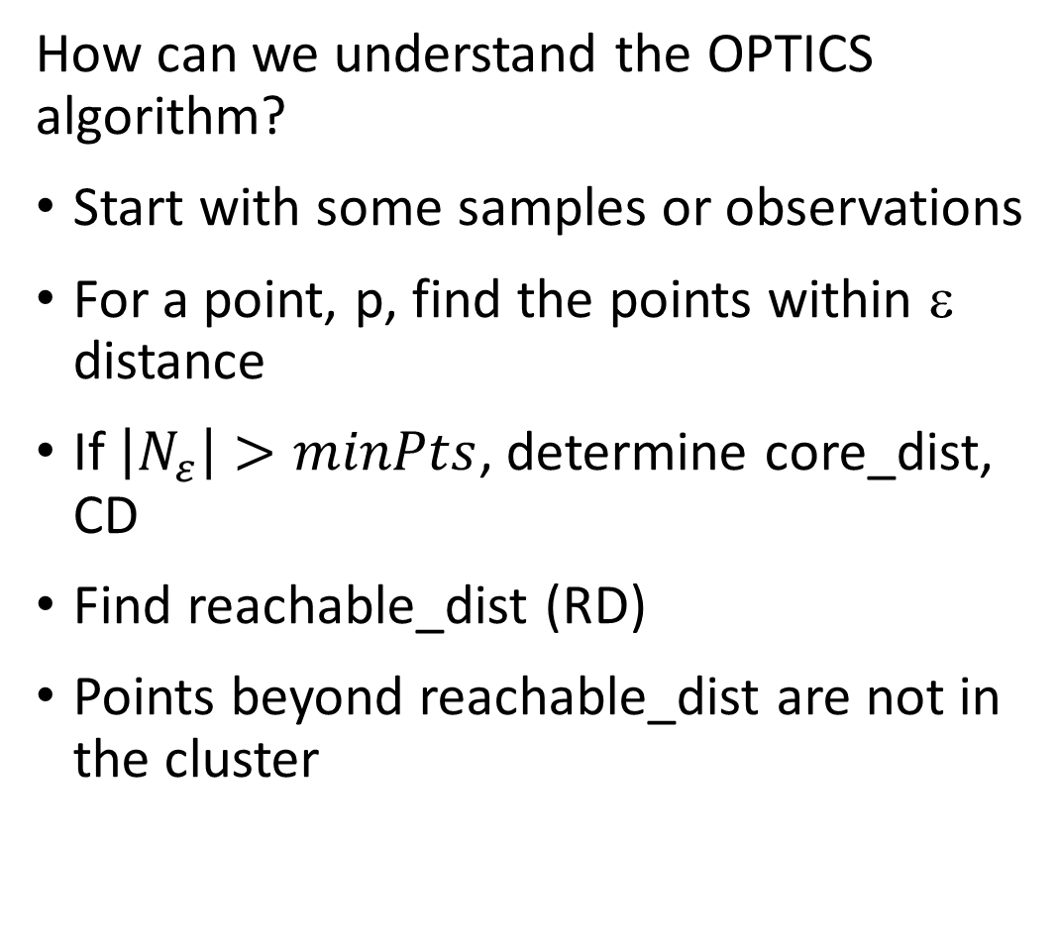
Density Clustering
How can we understand the OPTICS algorithm?
Start with some samples or observations
For a point, p, find the points within ε distance
If $\left|N_{ε}\right|>minPts$, determine core_dist, CD
Find reachable_dist (RD)
Points beyond reachable_dist are not in the cluster
ε
CD
RD

Slide 42
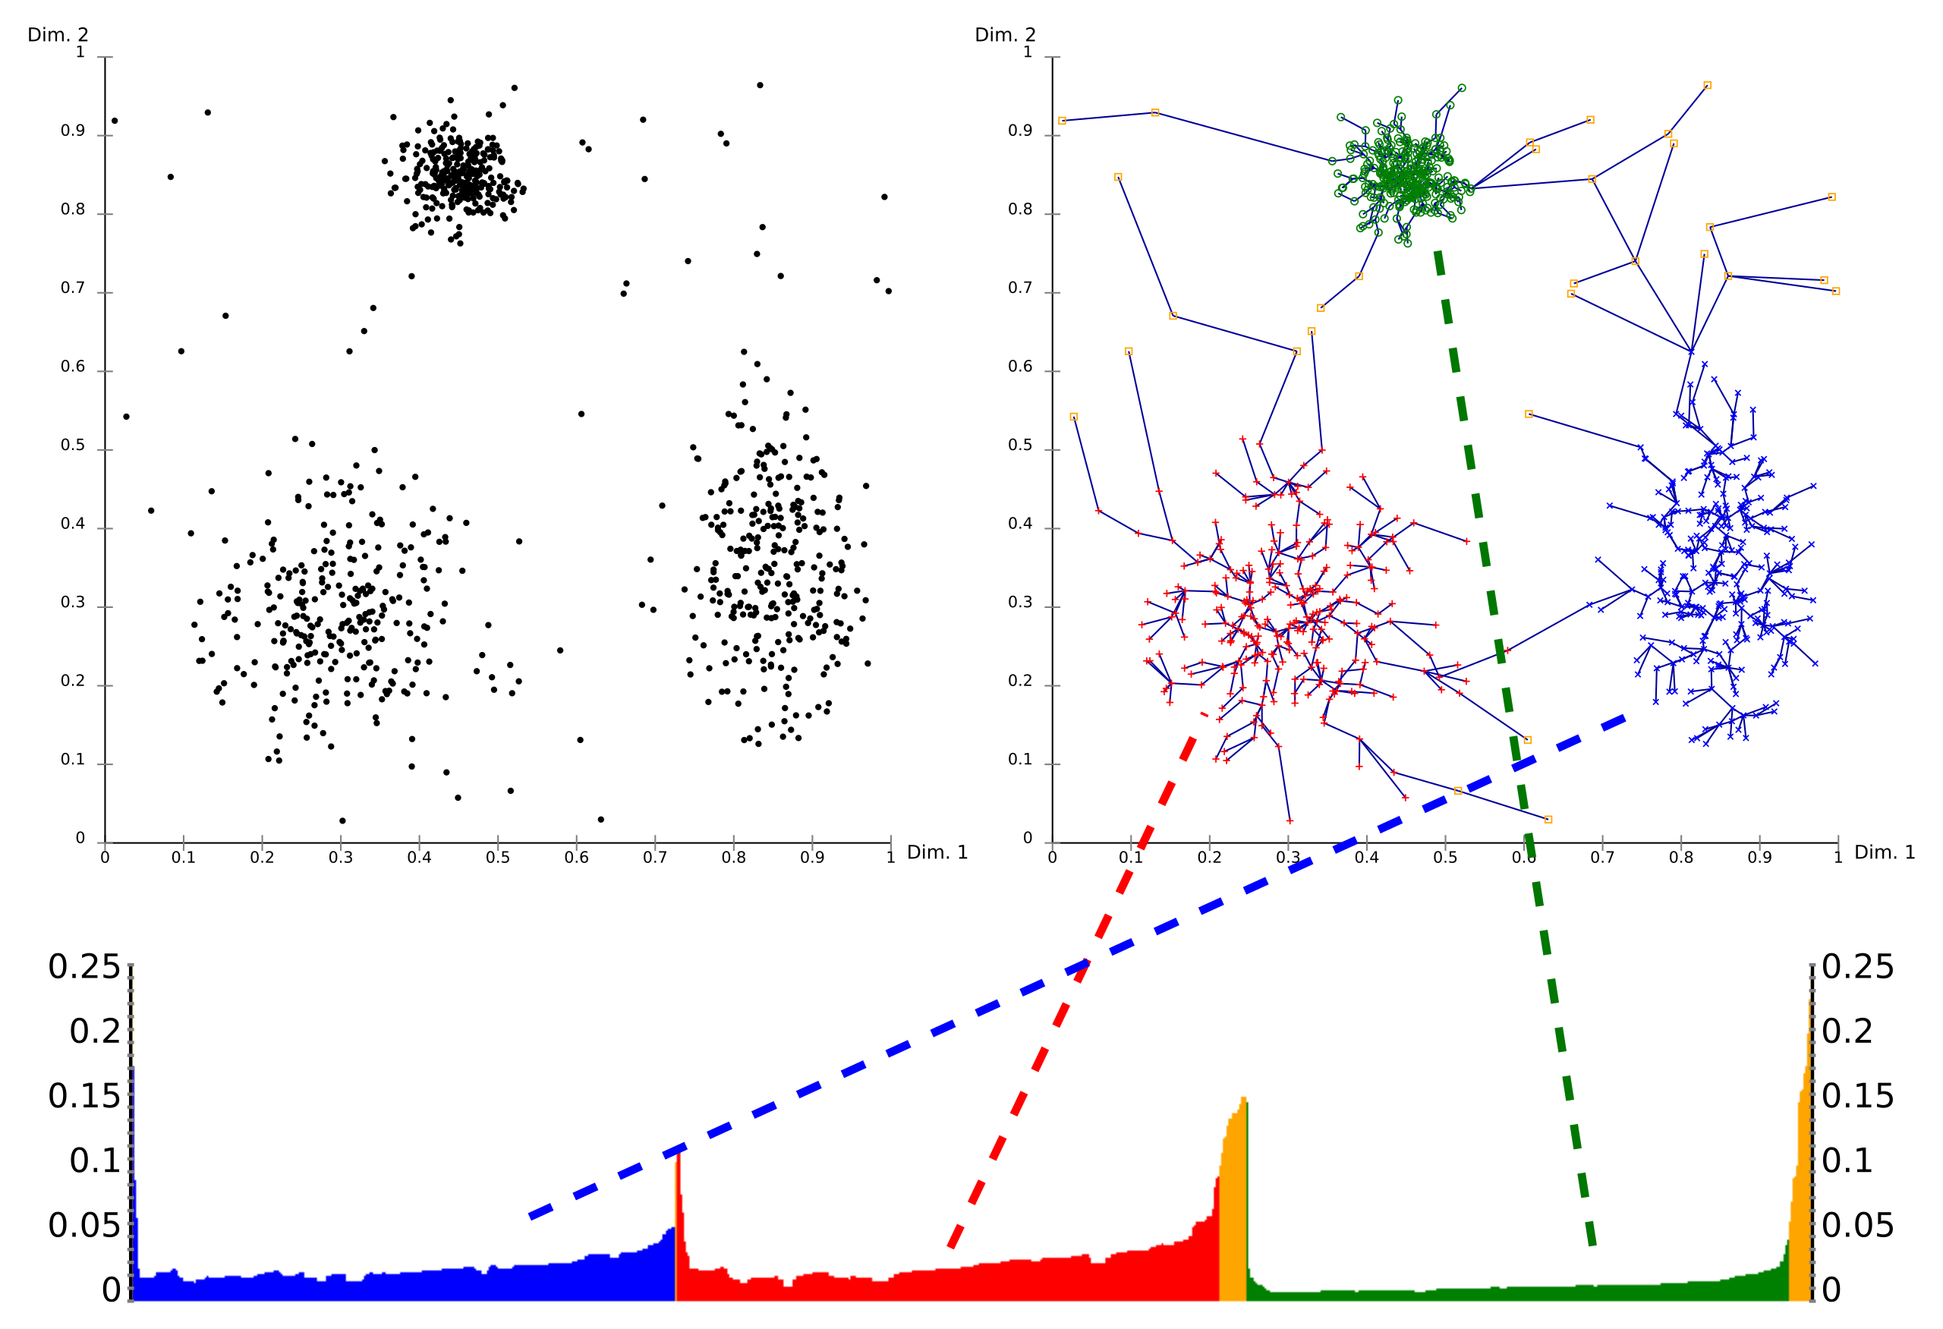
Density Clustering
What are some properties of OPTICS?
OPTICS builds a NN graph with the distances determining clusters
The graph defines a dendrogram
The reachability plot (bottom) shows the path distances in the dendrogram
A cutoff on the reachability plot defines the clusters
Credit: Wikipedia commons

Slide 43
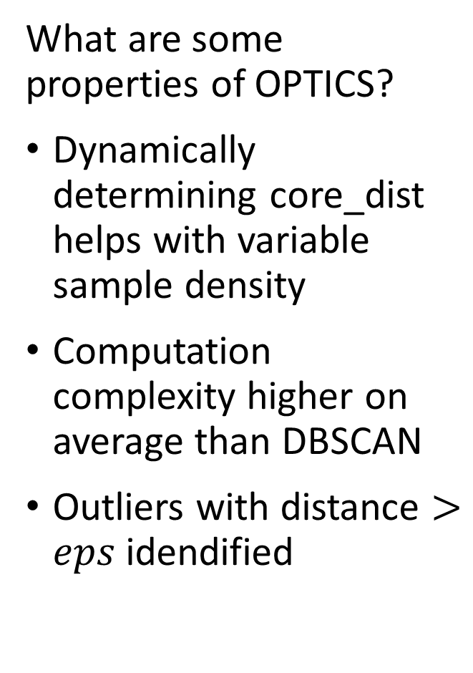
Density Clustering
What are some properties of OPTICS?
Dynamically determining core_dist helps with variable sample density
Computation complexity higher on average than DBSCAN
Outliers with distance $>eps$ idendified
Credit: Wikipedia commons

Slide 44
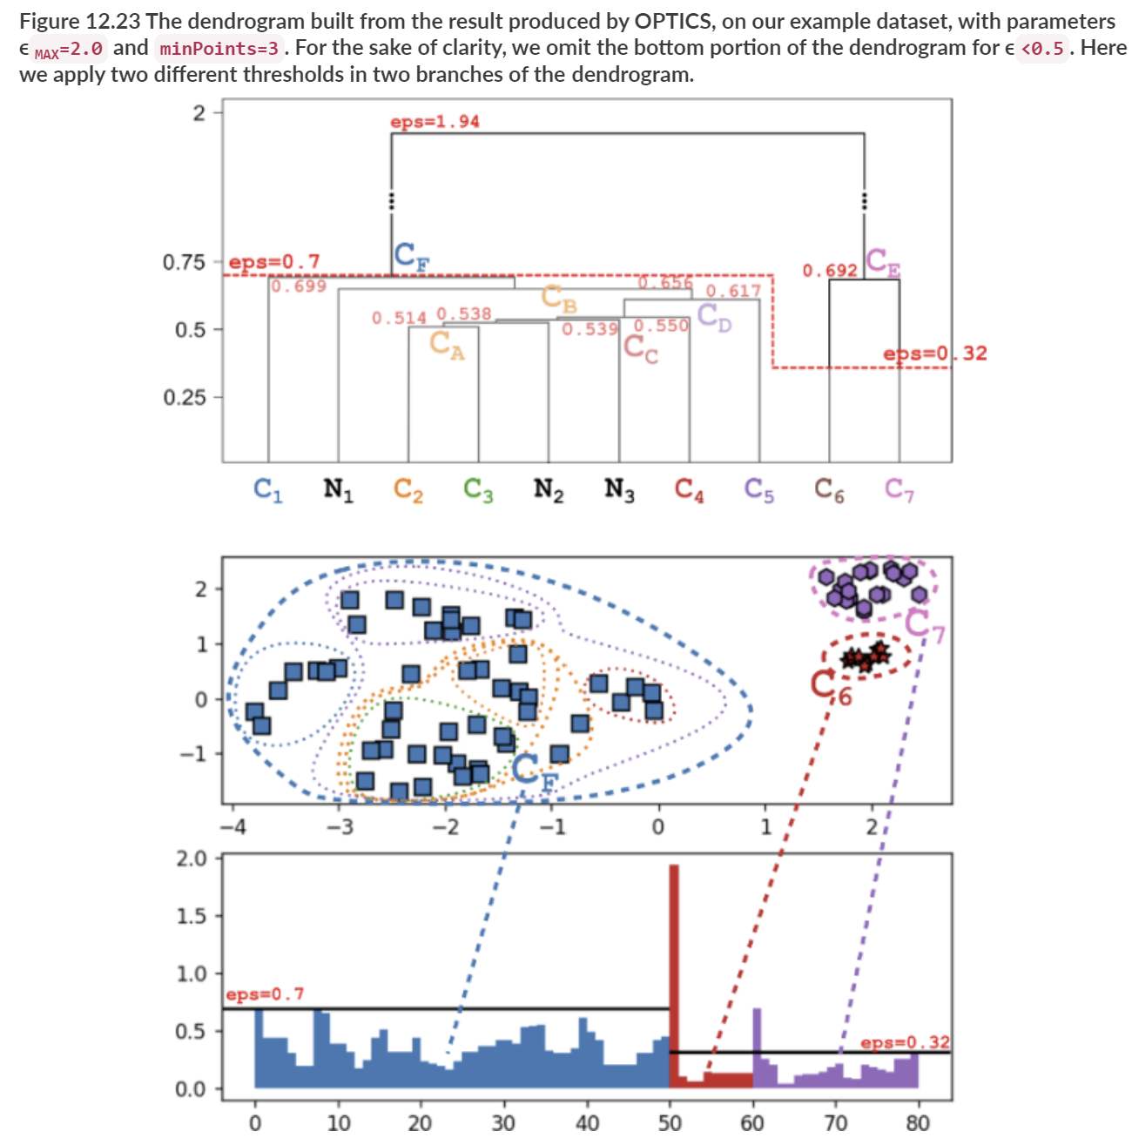
Density Clustering
OPTICS is an Hierarchical Algorithm
Dendrogram of reachability distances
Overlapping cluster assignments from partitioning graph at different eps
Reachability plot with local eps to define clusters from graph components
From Advanced Algorithms and Data Structures,, Marcello La Rocca, Manning, 2021

Slide 45
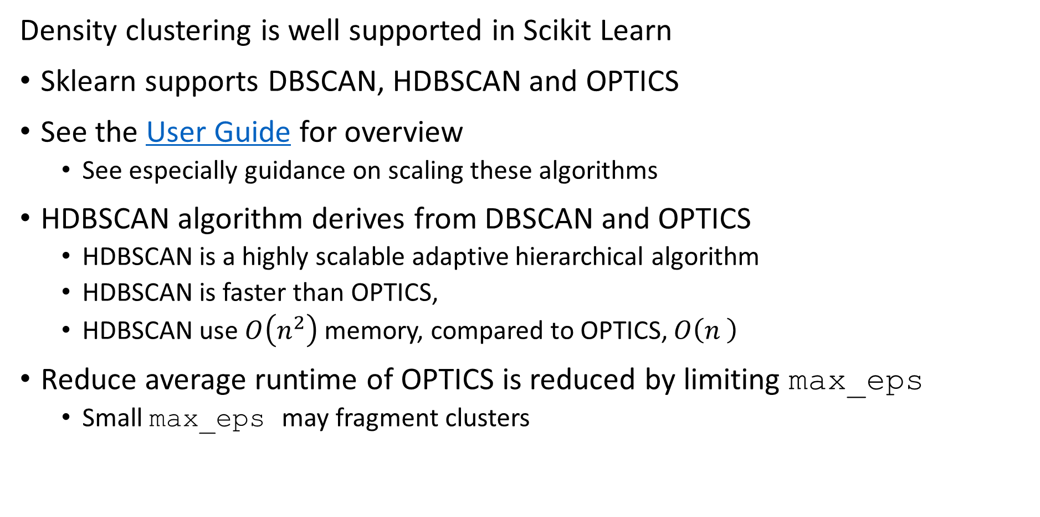
Density Clustering
Density clustering is well supported in Scikit Learn
Sklearn supports DBSCAN, HDBSCAN and OPTICS
See the User Guide for overview
See especially guidance on scaling these algorithms
HDBSCAN algorithm derives from DBSCAN and OPTICS
HDBSCAN is a highly scalable adaptive hierarchical algorithm
HDBSCAN is faster than OPTICS,
HDBSCAN use $O\left(n^{2}\right)$ memory, compared to OPTICS, $O\left(n^{ }\right)$
Reduce average runtime of OPTICS is reduced by limiting max_eps
Small max_eps may fragment clusters

Slide 46
Spectral Clustering Models

Slide 47
Spectral Clustering
Spectral clustering algorithm finds the minimum cuts by three steps
Construct association matrix for the graph of the samples
Fully connected graph or, sparse K-nearest-neighbor graph
KD-tree, ball-tree or other NN algorithm
The edges are undirected and weighted
Weights are similarity between the samples
Generally, use symmetric nearest neighbors
The graph Laplacian matrix is constructed from the associaton matrix
Full matrix for fully connected graph
Sparse matrix for nearest-neighbor graph – faster algorithm!
Partition graph Laplacian by minimum weight cuts
A min-cut algorithm

Slide 48
Spectral Clustering
Steps of spectral clustering algorithm
Start with samples
Construct graph
3-nearest-neighbors in this case
Use undirected edges
Edge weights are similarity
Association matrix constructed from graph
Weighted by similarity between points
Compute graph Laplacian
Perform clustering by partioning graph on eigenvectors of graph Laplacian

Slide 49
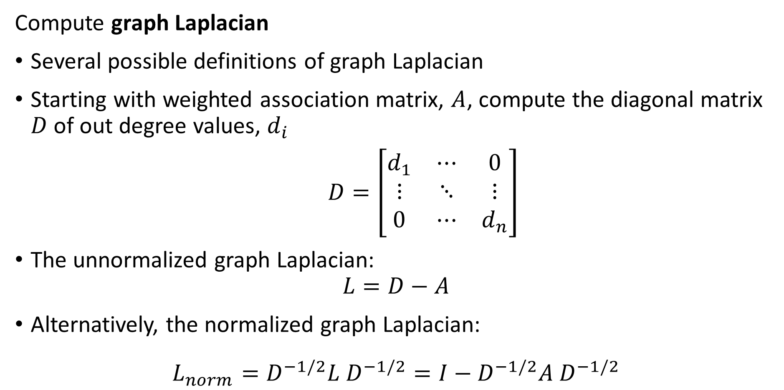
Spectral Clustering
Compute graph Laplacian
Several possible definitions of graph Laplacian
Starting with weighted association matrix, $A$, compute the diagonal matrix $D$ of out degree values, $d_{i}$
$D=\left[\begin{matrix}d_{1} & ⋯ & 0 \\ ⋮ & ⋱ & ⋮ \\ 0 & ⋯ & d_{n}\end{matrix}\right]$
The unnormalized graph Laplacian:
$$L=D−A$$
Alternatively, the normalized graph Laplacian:
$$L_{norm}=D^{−1/2}{L D}^{−1/2}=I−D^{−1/2}{A D}^{−1/2}$$

Slide 50
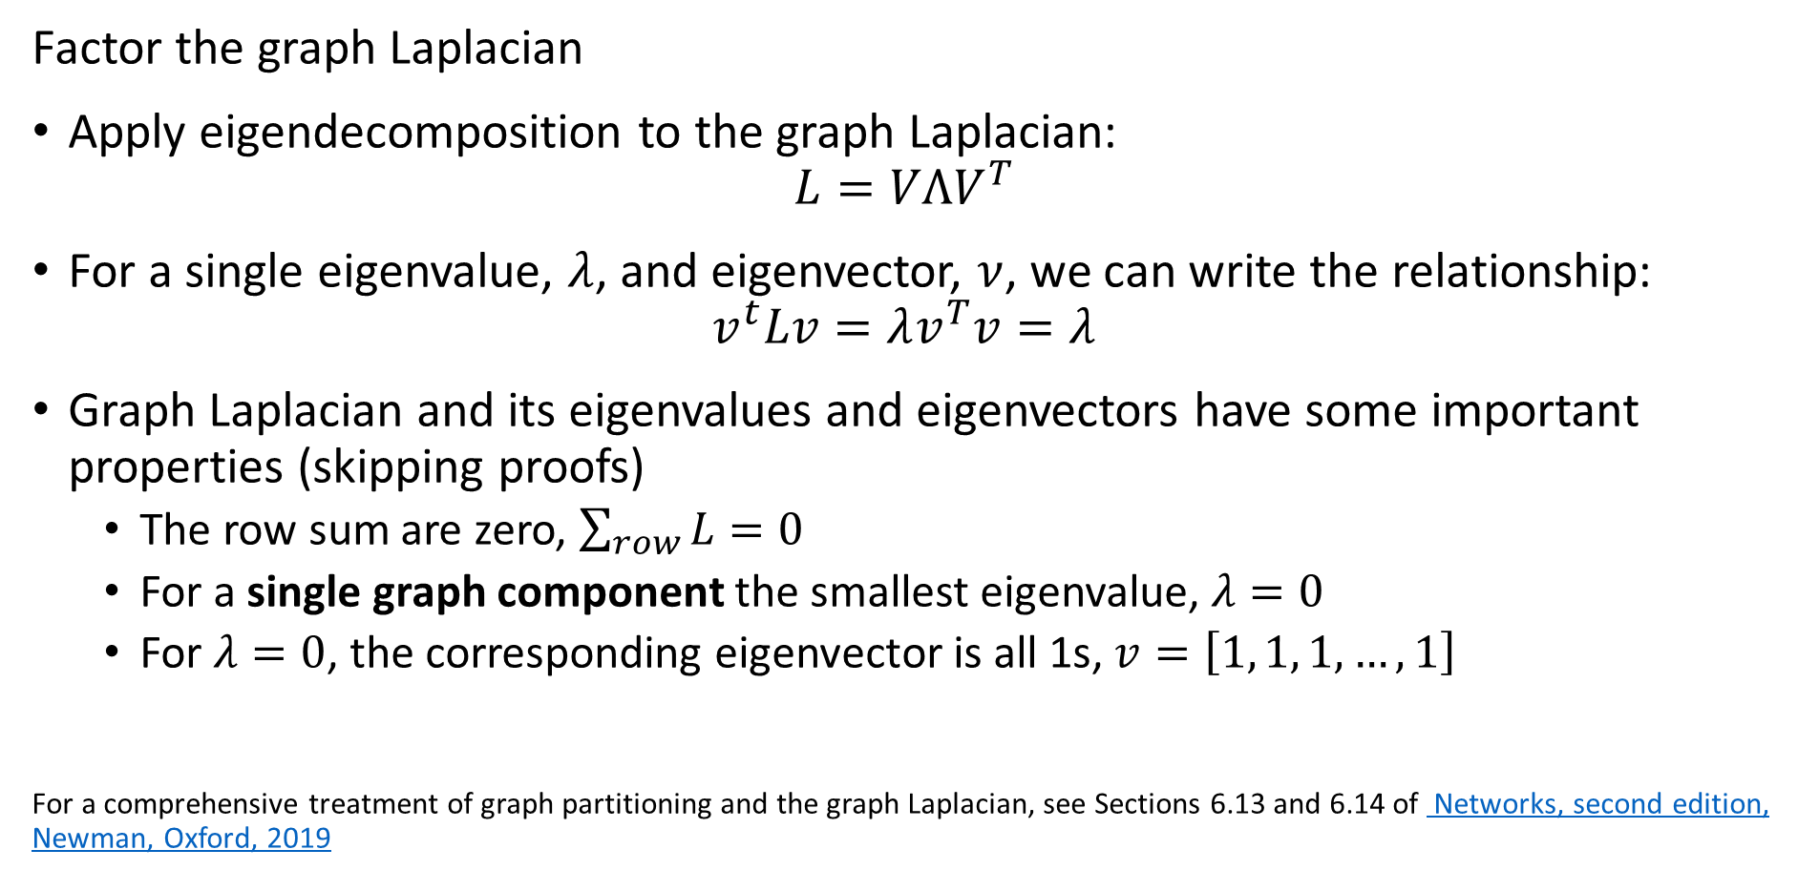
Spectral Clustering
Factor the graph Laplacian
Apply eigendecomposition to the graph Laplacian:
$$L=VΛV^{T}$$
For a single eigenvalue, $λ$, and eigenvector, $ν$, we can write the relationship:
$$v^{t}Lv=λv^{T}v=λ$$
Graph Laplacian and its eigenvalues and eigenvectors have some important properties (skipping proofs)
The row sum are zero, $\sum_{row}{L}=0$
For a single graph component the smallest eigenvalue, $λ=0$
For $λ=0$, the corresponding eigenvector is all 1s, $v=\left[1, 1, 1, …, 1\right]$
For a comprehensive treatment of graph partitioning and the graph Laplacian, see Sections 6.13 and 6.14 of Networks, second edition, Newman, Oxford, 2019

Slide 51
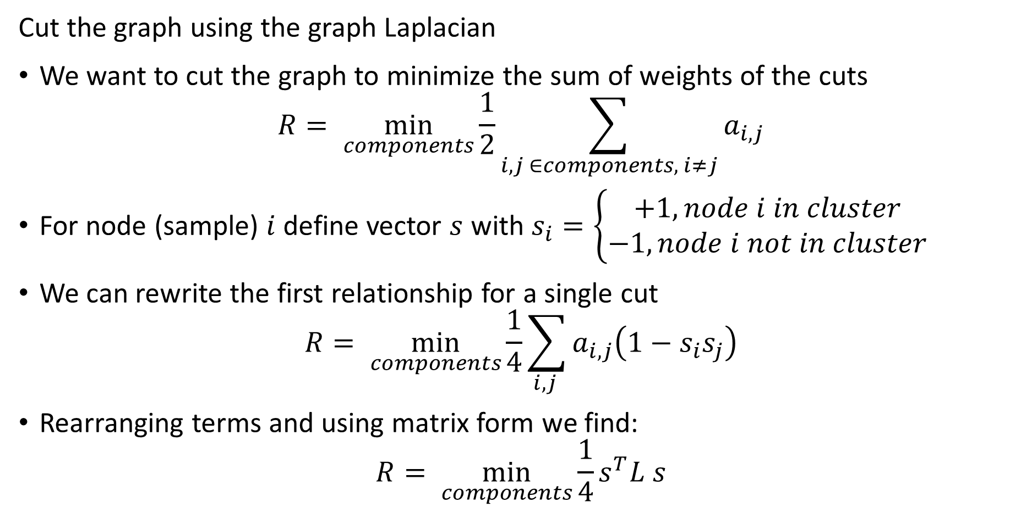
Spectral Clustering
Cut the graph using the graph Laplacian
We want to cut the graph to minimize the sum of weights of the cuts
$$R= \min_{components}{\frac{1}{2}\sum_{i,j ∈components, i≠j}{a_{i,j}}}$$
For node (sample) $i$ define vector $s$ with $s_{i}=\left\{\begin{aligned}+1, node i in cluster \\ −1, node i not in cluster\end{aligned}\right.$
We can rewrite the first relationship for a single cut
$$R= \min_{components}{\frac{1}{4}\sum_{i,j }{a_{i,j}\left(1−s_{i}s_{j}\right)}}$$
Rearranging terms and using matrix form we find:
$$R= \min_{components}{\frac{1}{4}s^{T}L s}$$

Slide 52
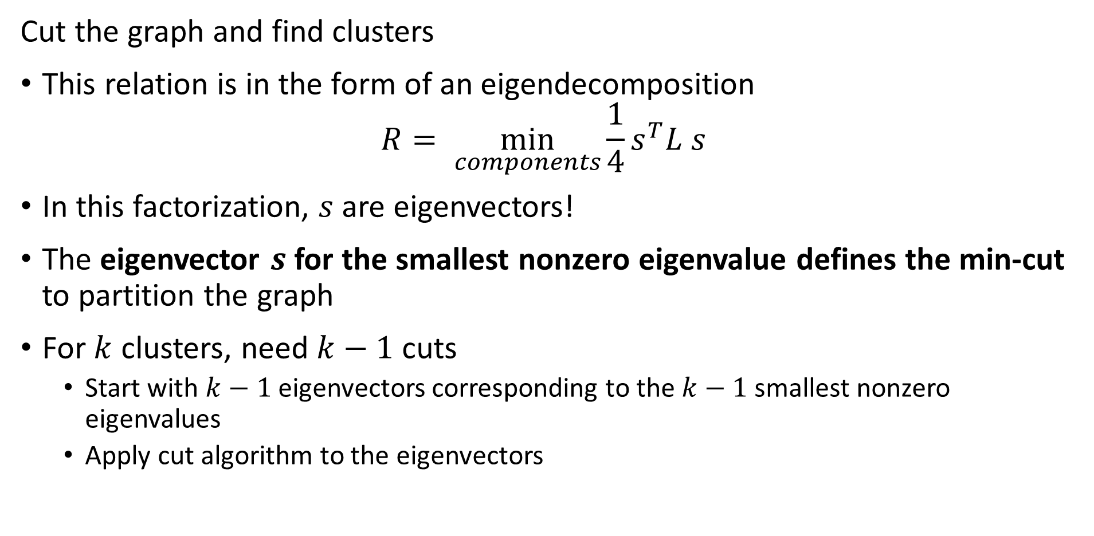
Spectral Clustering
Cut the graph and find clusters
This relation is in the form of an eigendecomposition
$$R= \min_{components}{\frac{1}{4}s^{T}L s}$$
In this factorization, $s$ are eigenvectors!
The eigenvector $s$ for the smallest nonzero eigenvalue defines the min-cut to partition the graph
For $k$ clusters, need $k−1$ cuts
Start with $k−1$ eigenvectors corresponding to the $k−1$ smallest nonzero eigenvalues
Apply cut algorithm to the eigenvectors

Slide 53
Spectral Clustering
Spectral clustering is a graph-based state of the art clustering method
Spectral clustering follows these steps:
Construct the association matrix
Compute the graph Laplacian from the association matrix
Factor the graph Laplacian
Partition the graph by k-1 eigenvectors
In summary, spectral clustering constructs clusters on the orthogonal projections of the Laplacian matrix
For a rigorous introduction to spectral clustering see this tutorial article by von Luxburg

Slide 54
Clustering in High Dimensions and The Curse of Dimensionality!

Slide 55
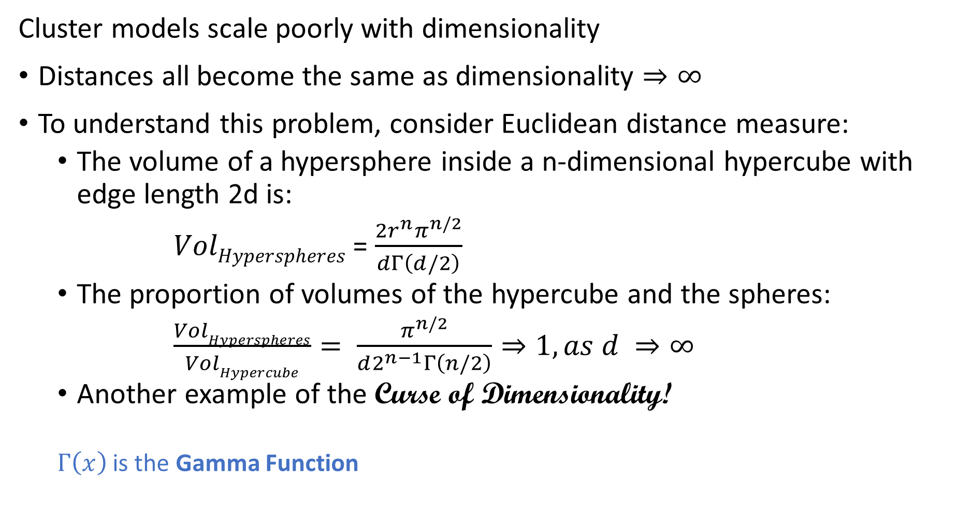
What Could Possibly Go Wrong? Curse of Dimensionality
Cluster models scale poorly with dimensionality
Distances all become the same as dimensionality $⇒∞$
To understand this problem, consider Euclidean distance measure:
The volume of a hypersphere inside a n-dimensional hypercube with edge length 2d is:
$VolHyperspheres$ = $\frac{2r^{n}π^{n/2}}{dΓ\left(d/2\right)}$
The proportion of volumes of the hypercube and the spheres:
$\frac{VolHyperspheres}{VolHypercube}= \frac{π^{n/2}}{d2^{n−1}Γ\left(n/2\right)}⇒1, as d ⇒∞$
Another example of the Curse of Dimensionality!
$Γ\left(x\right)$ is the Gamma Function

Slide 56
What Could Possibly Go Wrong? Curse of Dimensionality
The curse of dimensionality means that all clusters are the same in high dimensions
Sampling density decreases exponentially
Distances converge to the same value in a high dimensional space
The choice of metric does not help
All distances are the same in high dimensions!
Implication is that high-dimensional cluster models are easy to overfit!!

Slide 57
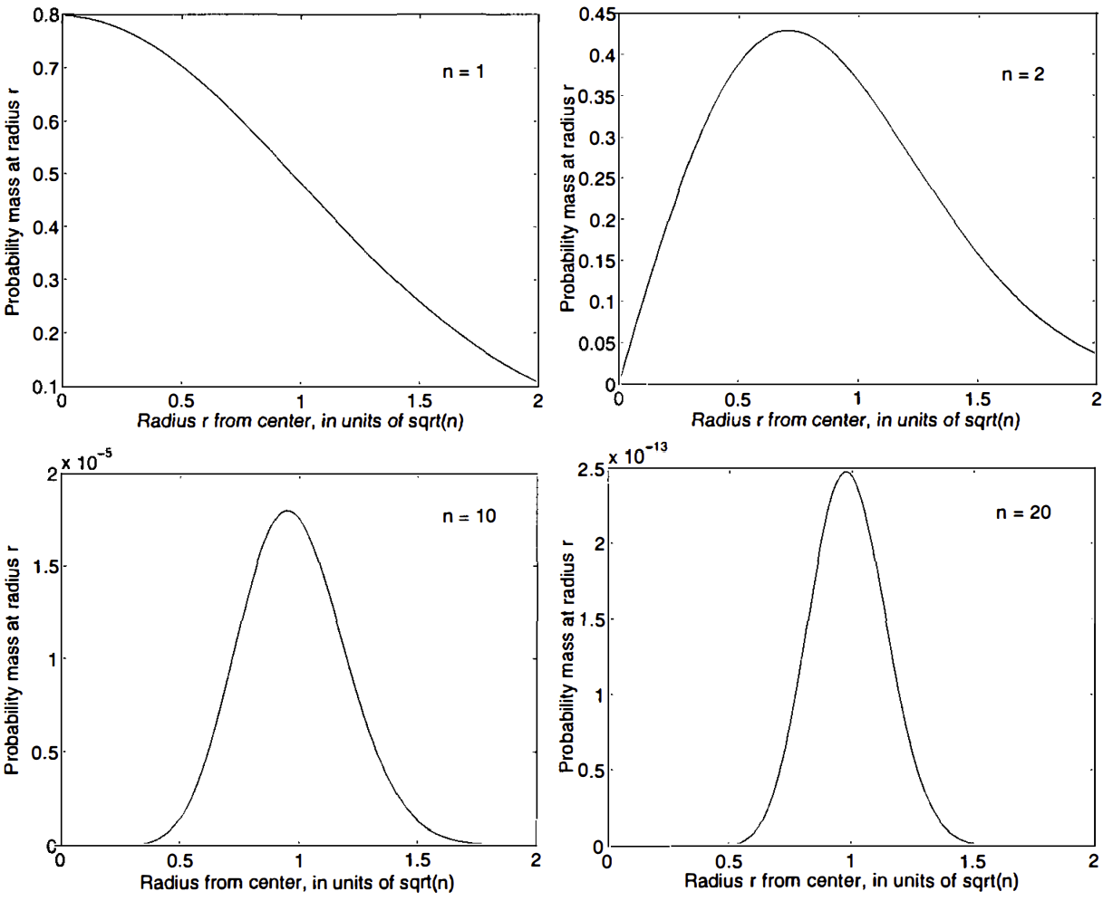
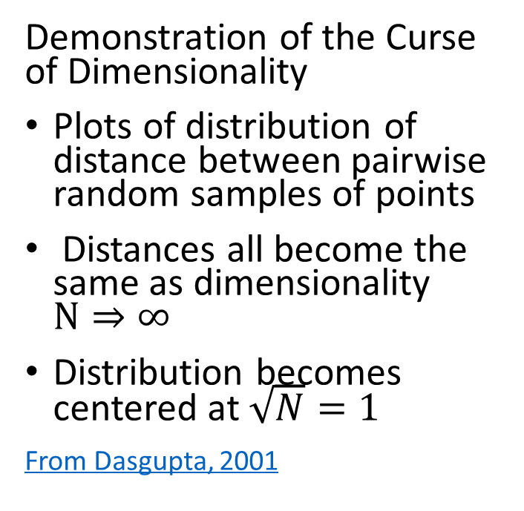
What Could Possibly Go Wrong? Curse of Dimensionality
Demonstration of the Curse of Dimensionality
Plots of distribution of distance between pairwise random samples of points
Distances all become the same as dimensionality $N⇒∞$
Distribution becomes centered at $\sqrt{N}=1$
From Dasgupta, 2001

Slide 58
What Could Possibly Go Wrong? Curse of Dimensionality
How can we extend clustering to higher dimensions?
Reducing dimensionality can help
Need to create a lower dimensional embedding
But how?
PCA is a linear Euclidian projection
Several families of alternatives
Subspace clustering
Random projection
Manifold learning
Our next lesson!

Slide 59
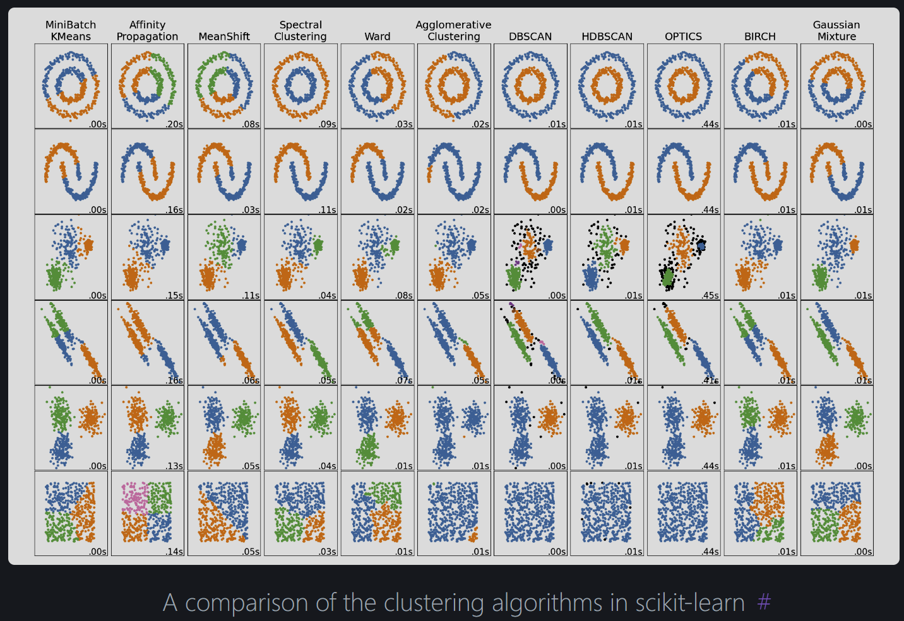
Summary
From Scikit-Learn Clustering User Guide

Slide 60
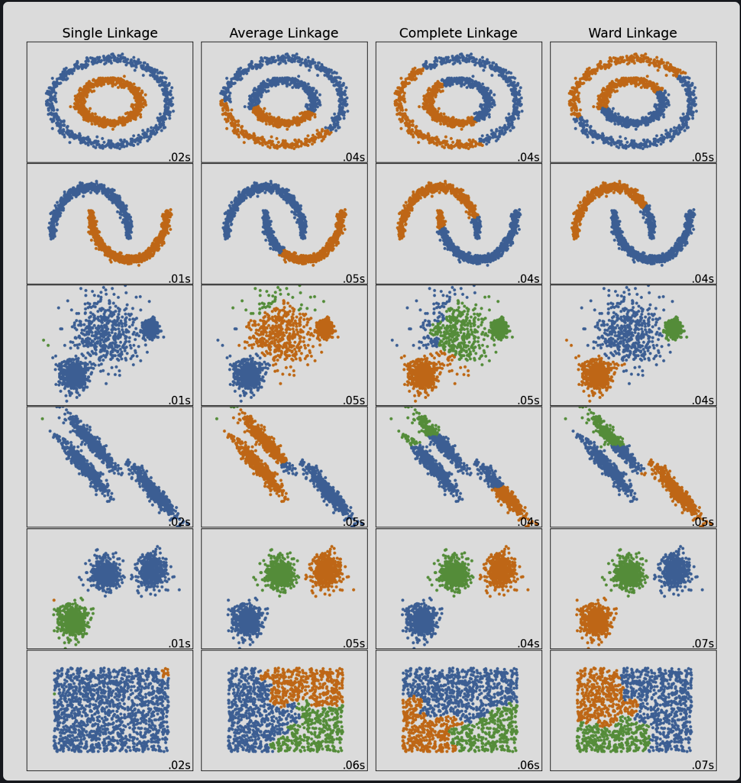
Summary
From Scikit-Learn Clustering User Guide

Slide 61
Summary
Unsupervised learning methods learn structure of data
Structure is learned by determining association between cases
Association based on measures of proximity, distance or dissimilarity
Clustering algorithms are data mining methods
Data mining seeks to find interesting relationships in data
We have already encountered feature importance as a data mining method

Slide 62
Summary
Algorithms can use different distance or dissimilarity metrics
Structure based on distance metrics
Different algorithms use different metrics
Metric can matter more than choice of algorithm
Good clusters have two properties
Compactness: We what the clusters to be small with members close to each other
Separation: We want the clusters are well separated, a closeness property

Slide 63
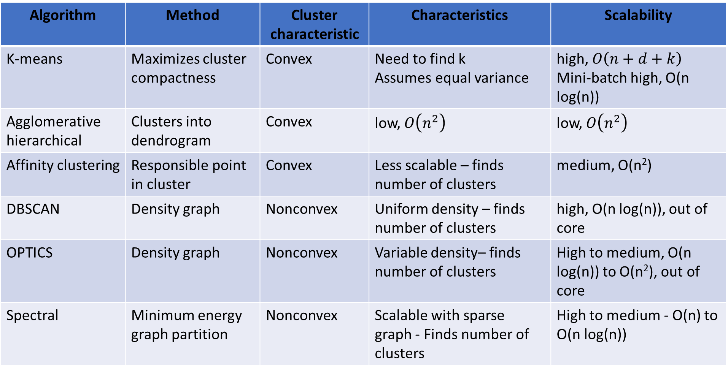
Summary
Algorithm | Method | Cluster characteristic | Characteristics | Scalability
K-means | Maximizes cluster compactness | Convex | Need to find k Assumes equal variance | high, $O\left(n+d+k\right)$ Mini-batch high, O(n log(n))
Agglomerative hierarchical | Clusters into dendrogram | Convex | low, $O\left(n^{2}\right)$ | low, $O\left(n^{2}\right)$
Affinity clustering | Responsible point in cluster | Convex | Less scalable – finds number of clusters | medium, O(n²)
DBSCAN | Density graph | Nonconvex | Uniform density – finds number of clusters | high, O(n log(n)), out of core
OPTICS | Density graph | Nonconvex | Variable density– finds number of clusters | High to medium, O(n log(n)) to O(n²), out of core
Spectral | Minimum energy graph partition | Nonconvex | Scalable with sparse graph - Finds number of clusters | High to medium - O(n) to O(n log(n))

